Slide 1

































Microsoft Azure Data Analytics Platform アーキテクチャ
Generate
Ingest
Store
Process
Enrich
Serve
Consume
On-Prems / Cloud
Realtime
Stream
Hot Path
IoT Hub
Batch
Functions
Dashboard
Event Hubs
Stream Analytics
Cognitive Services
SQL Database
Analytics
Machine Learning
Cold Path
Cosmos DB
Data-driven Applications
NoSQL
HTAP with Synapse Link
Data Lake
Data Share
Shared Datasets
Discover & Govern
Azure Purview
Azure Active Directory
Azure Cost Management
Azure Key Vault
Azure Security Center
Platform
Azure Monitor
Azure DevOps
GitHub
Azure Policy

Slide 2

Microsoft Azure Data Analytics Platform アーキテクチャ
Generate
Ingest
Store
Process
Enrich
Serve
Consume
On-Prems / Cloud
Realtime
Stream
Hot Path
IoT Hub
Batch
Functions
Power BI Premium
Dashboard
Event Hubs
Stream Analytics
Unstructured Semi Structured
Cognitive Services
Analytics
SQL Database
Relational
Dedicated SQL
Data Explorer
Machine Learning
Cold Path
Dataflow
Cosmos DB
Data-driven Applications
Pipeline
NoSQL
Serverless Spark
Serverless SQL
HTAP with Synapse Link
Data Lake
Data Share
Shared Datasets
Discover & Govern
Azure Purview
Azure Active Directory
Azure Cost Management
Azure Key Vault
Azure Security Center
Platform
Azure Monitor
Azure DevOps
GitHub
Azure Policy

Slide 3
第4章：ハンズオンの概要とハンズオンリソースの準備
Generate
Ingest
Store
Process
Enrich
Serve
Consume
On-Prems / Cloud
Realtime
Stream
Hot Path
IoT Hub
Batch
Functions
Power BI Premium
Dashboard
Event Hubs
Stream Analytics
Unstructured Semi Structured
Cognitive Services
Analytics
SQL Database
Relational
Dedicated SQL
Data Explorer
Machine Learning
Cold Path
Dataflow
Cosmos DB
Data-driven Applications
Pipeline
NoSQL
Serverless Spark
Serverless SQL
HTAP with Synapse Link
Data Lake
Data Share
Shared Datasets
Discover & Govern
Azure Purview
Azure Active Directory
Azure Cost Management
Azure Key Vault
Azure Security Center
Platform
Azure Monitor
Azure DevOps
GitHub
Azure Policy

Slide 4
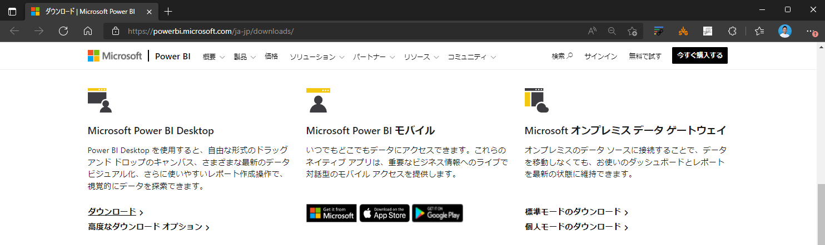

Slide 5
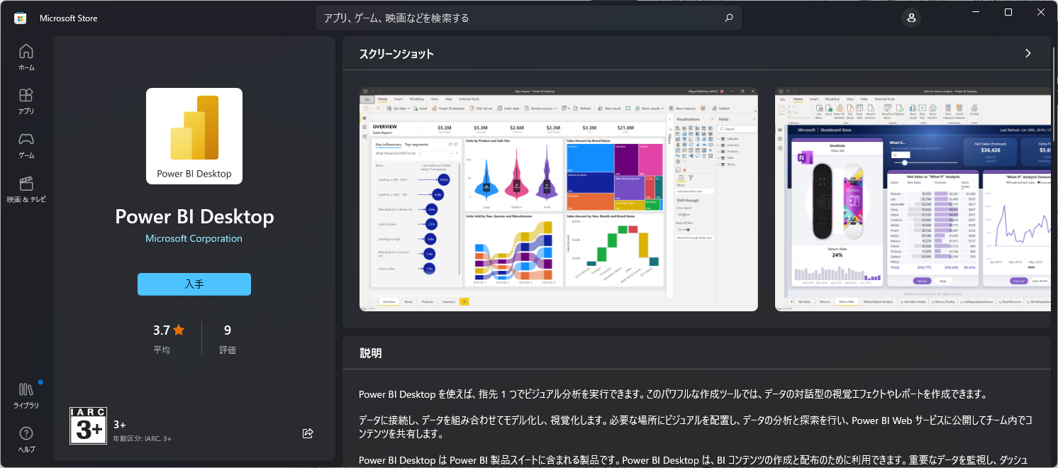

Slide 6
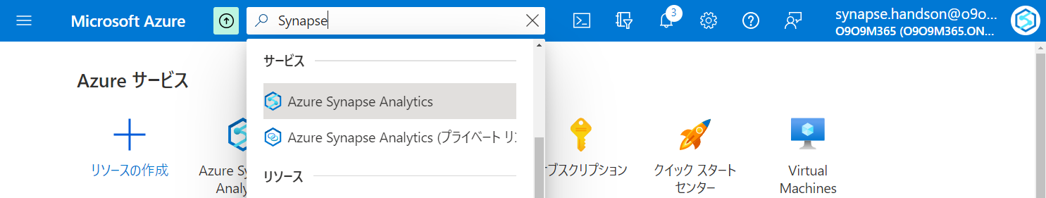

Slide 7
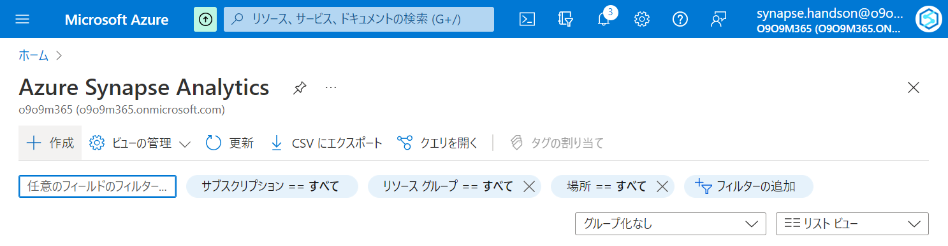

Slide 8
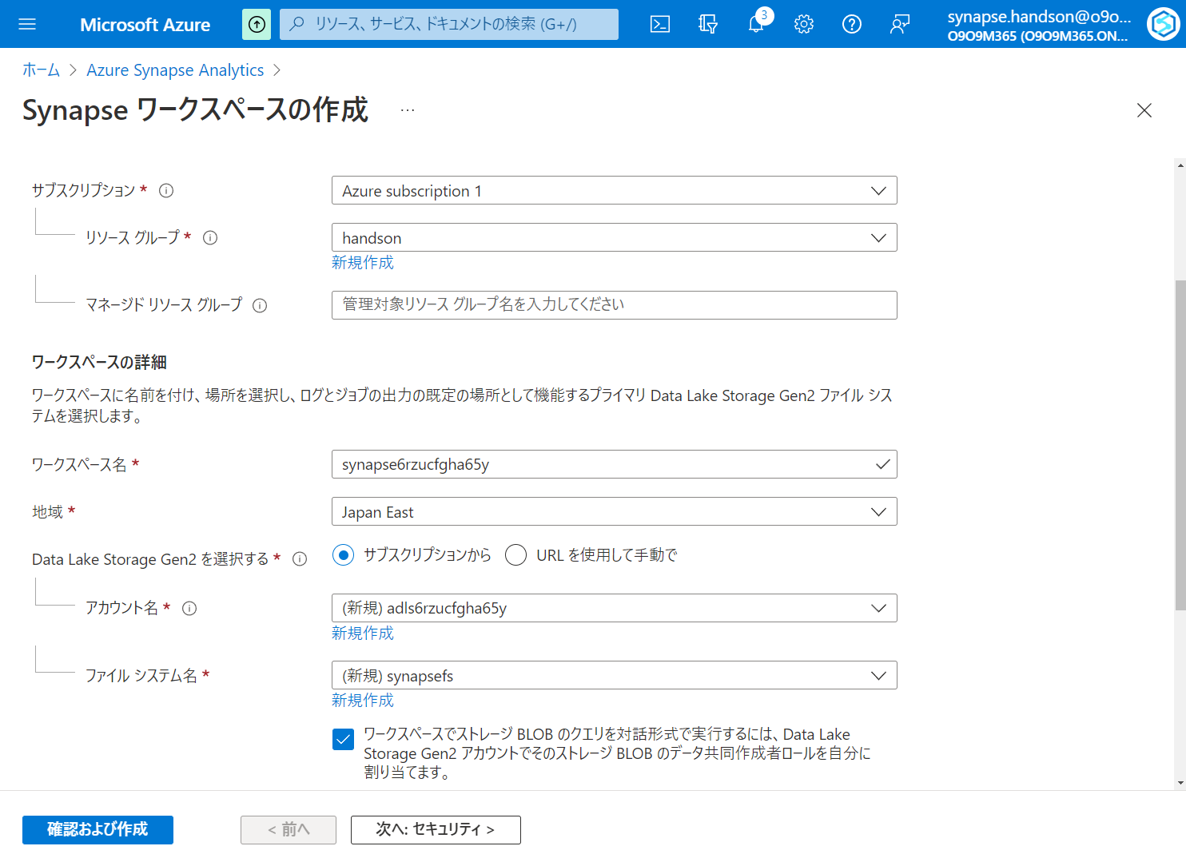

Slide 9
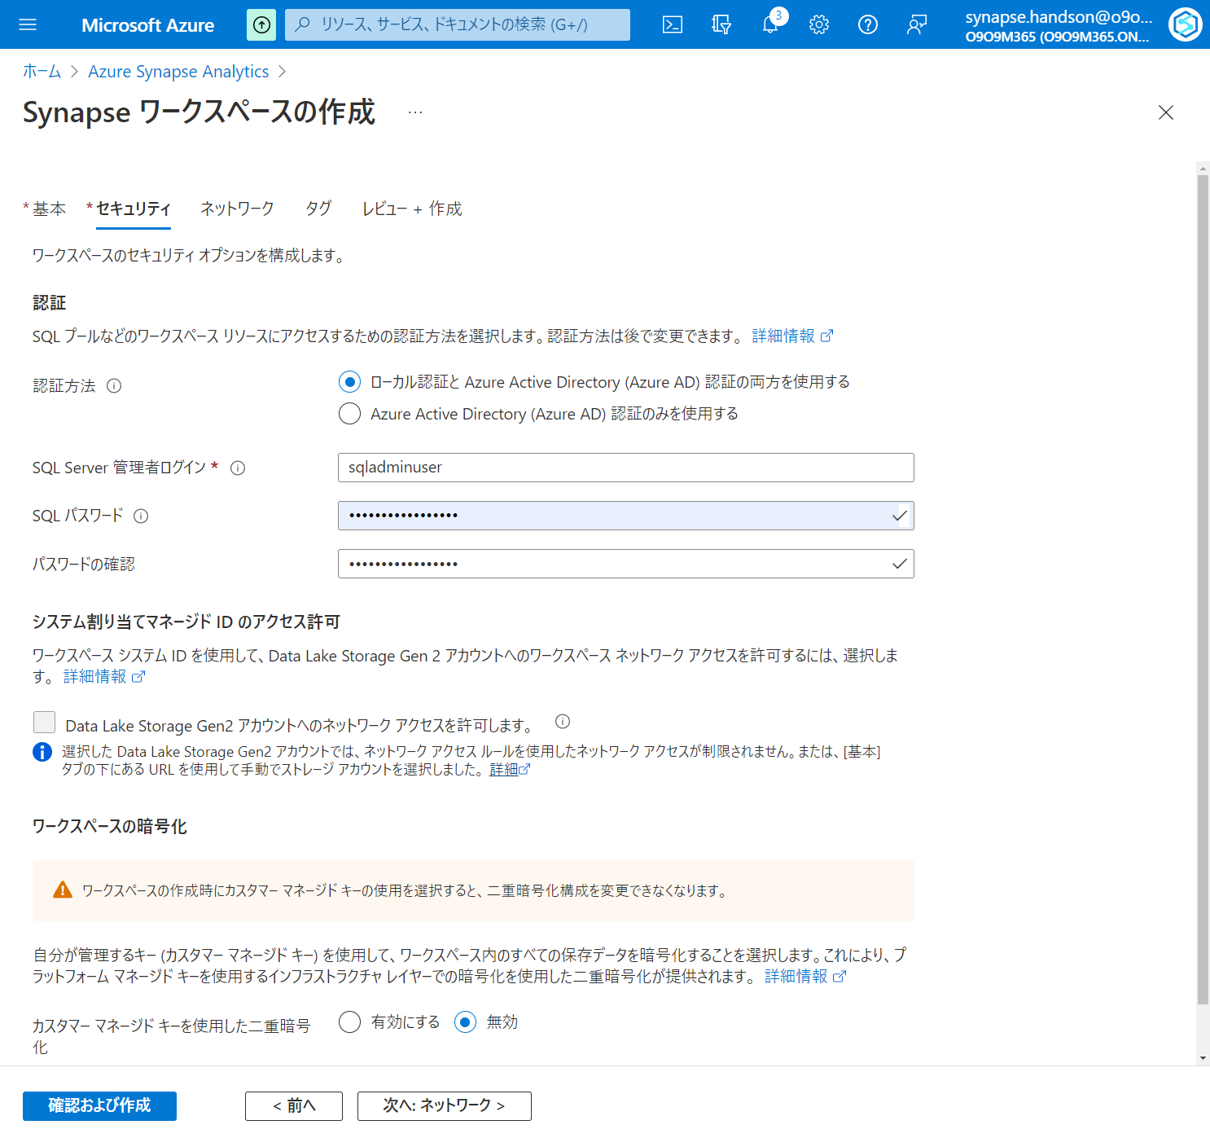

Slide 10
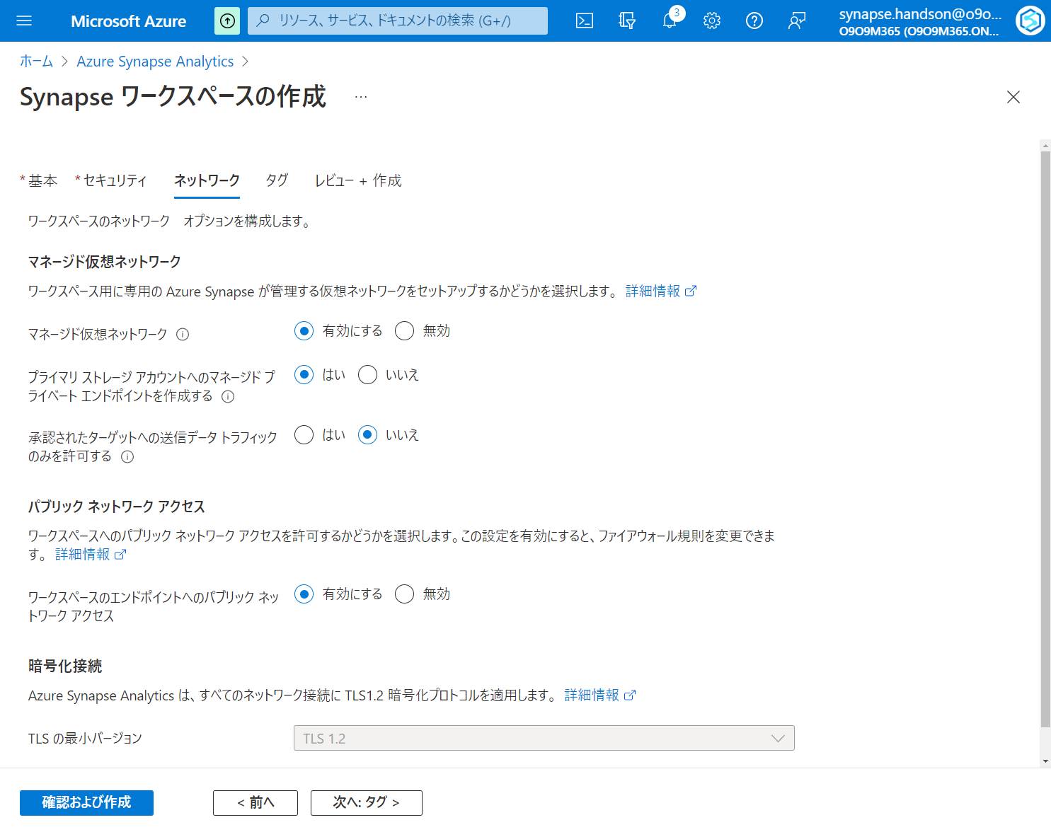

Slide 11
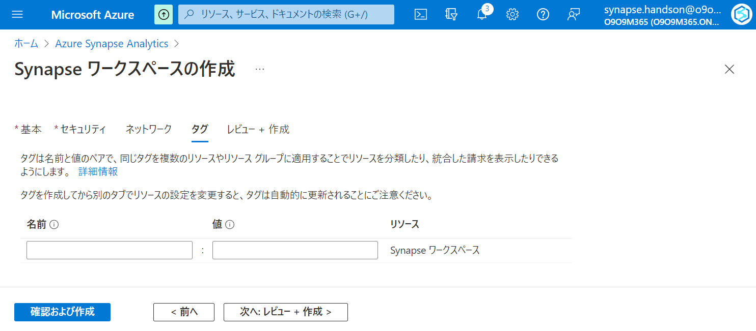

Slide 12
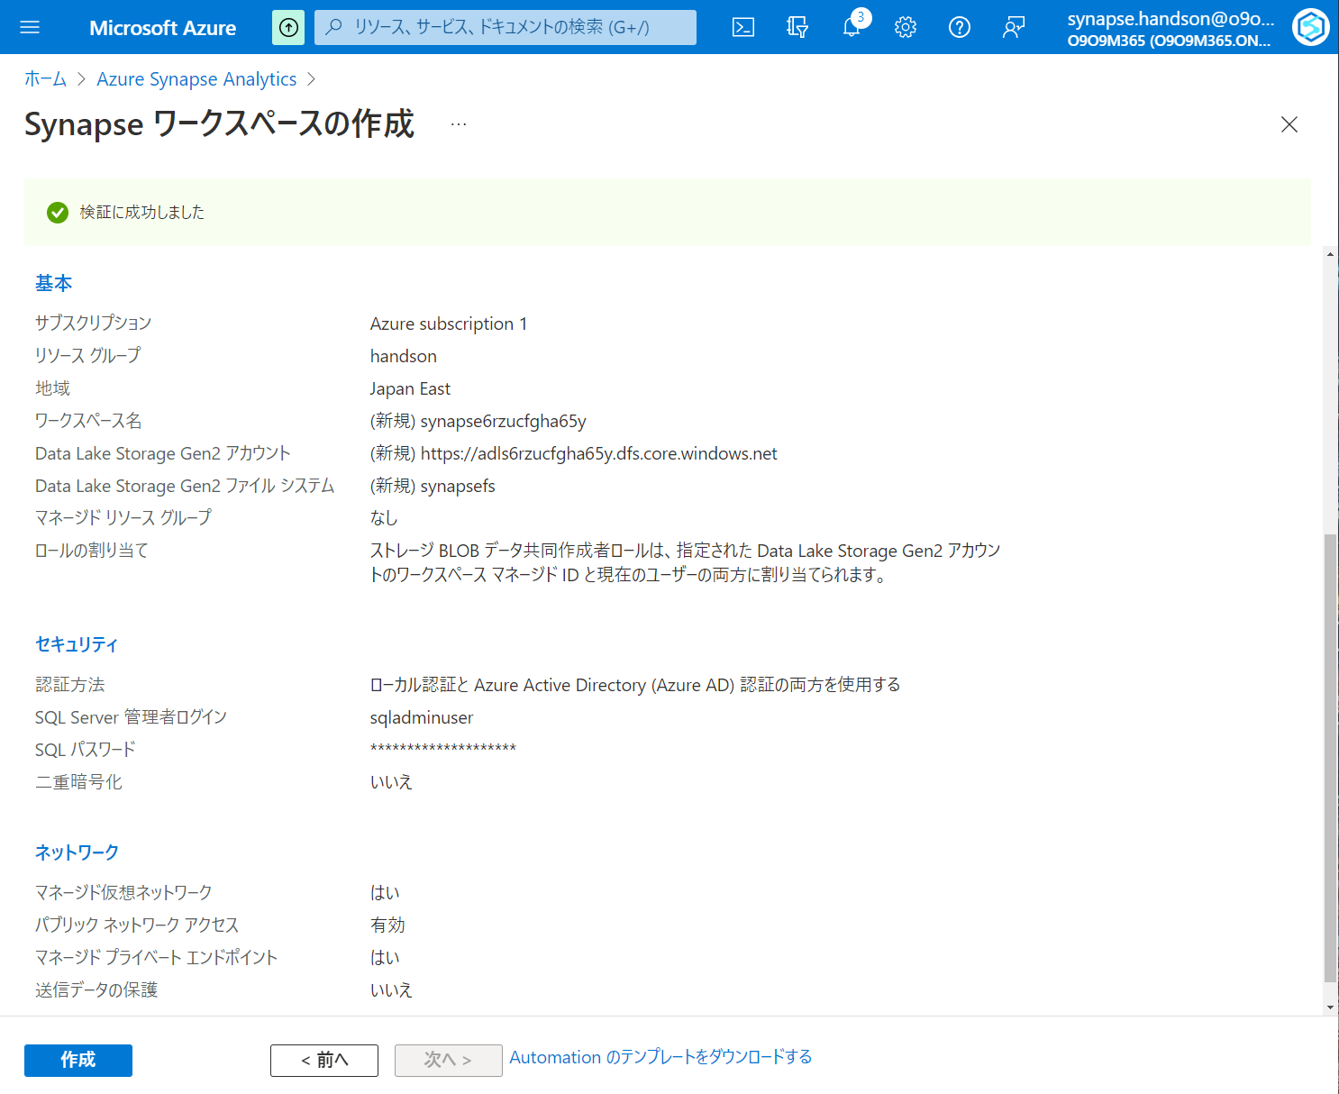

Slide 13
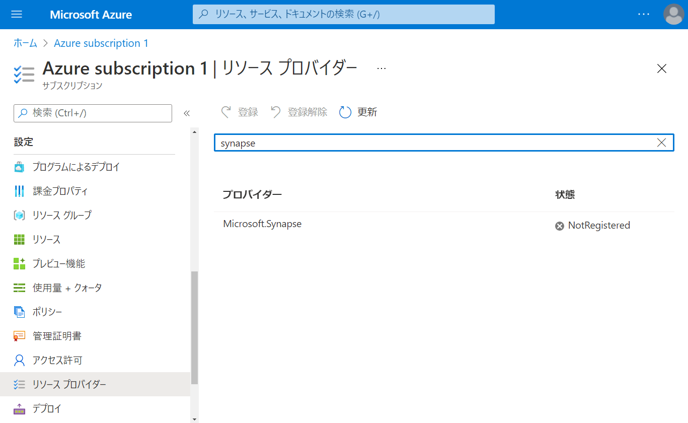

Slide 14
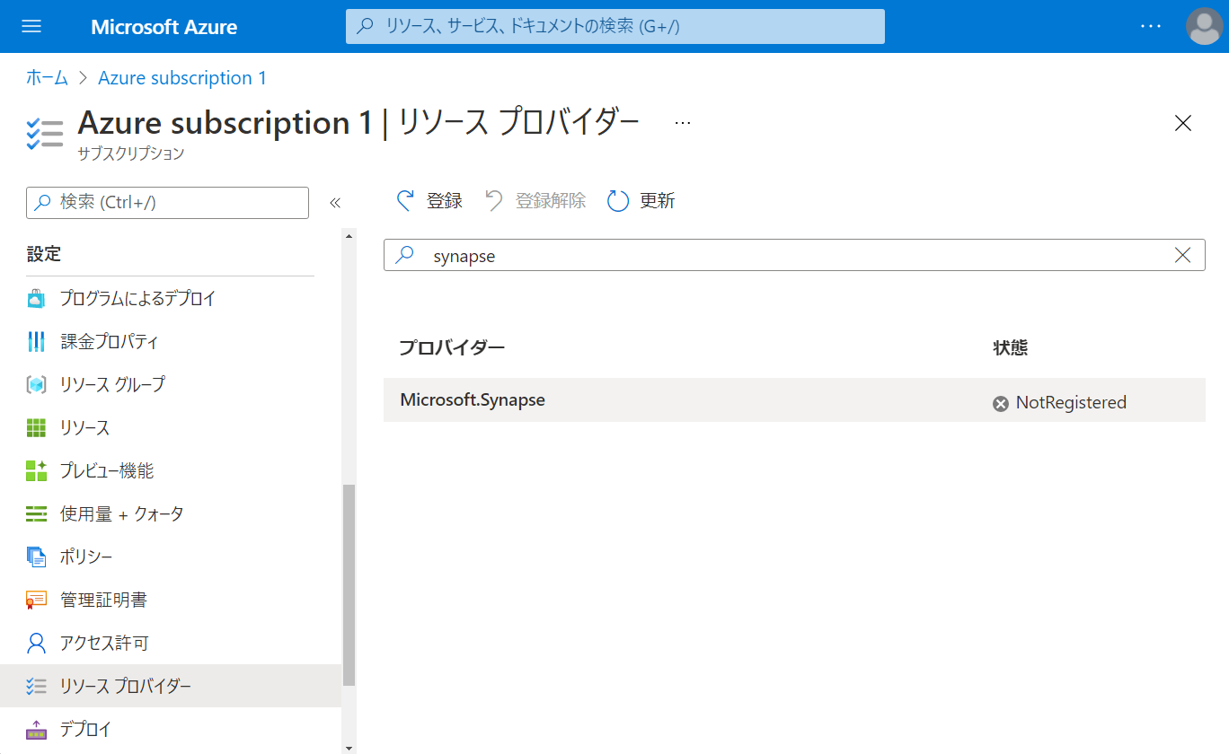

Slide 15
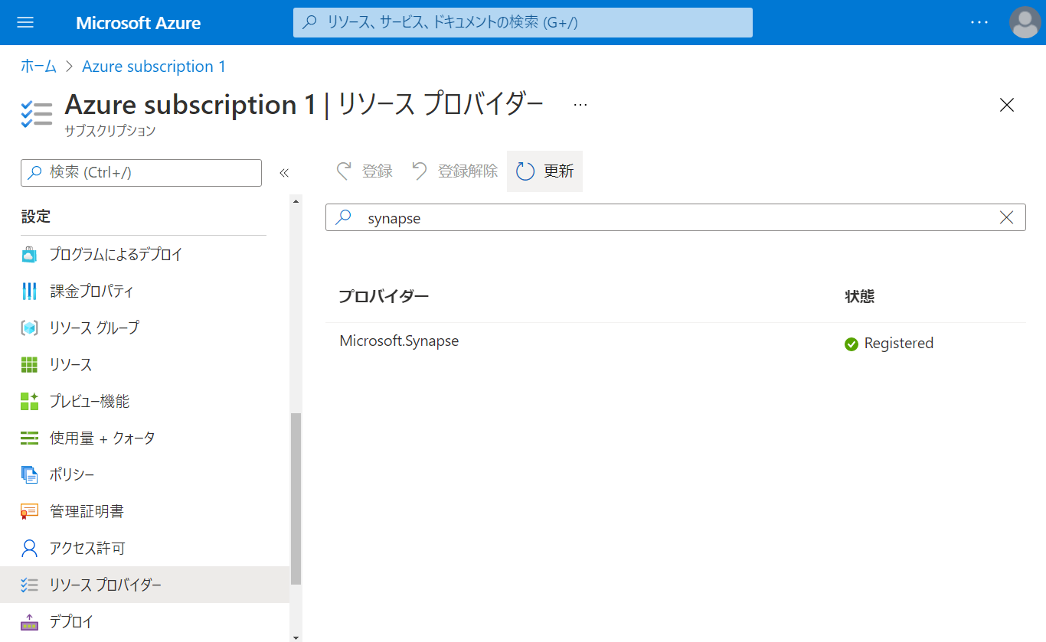

Slide 16
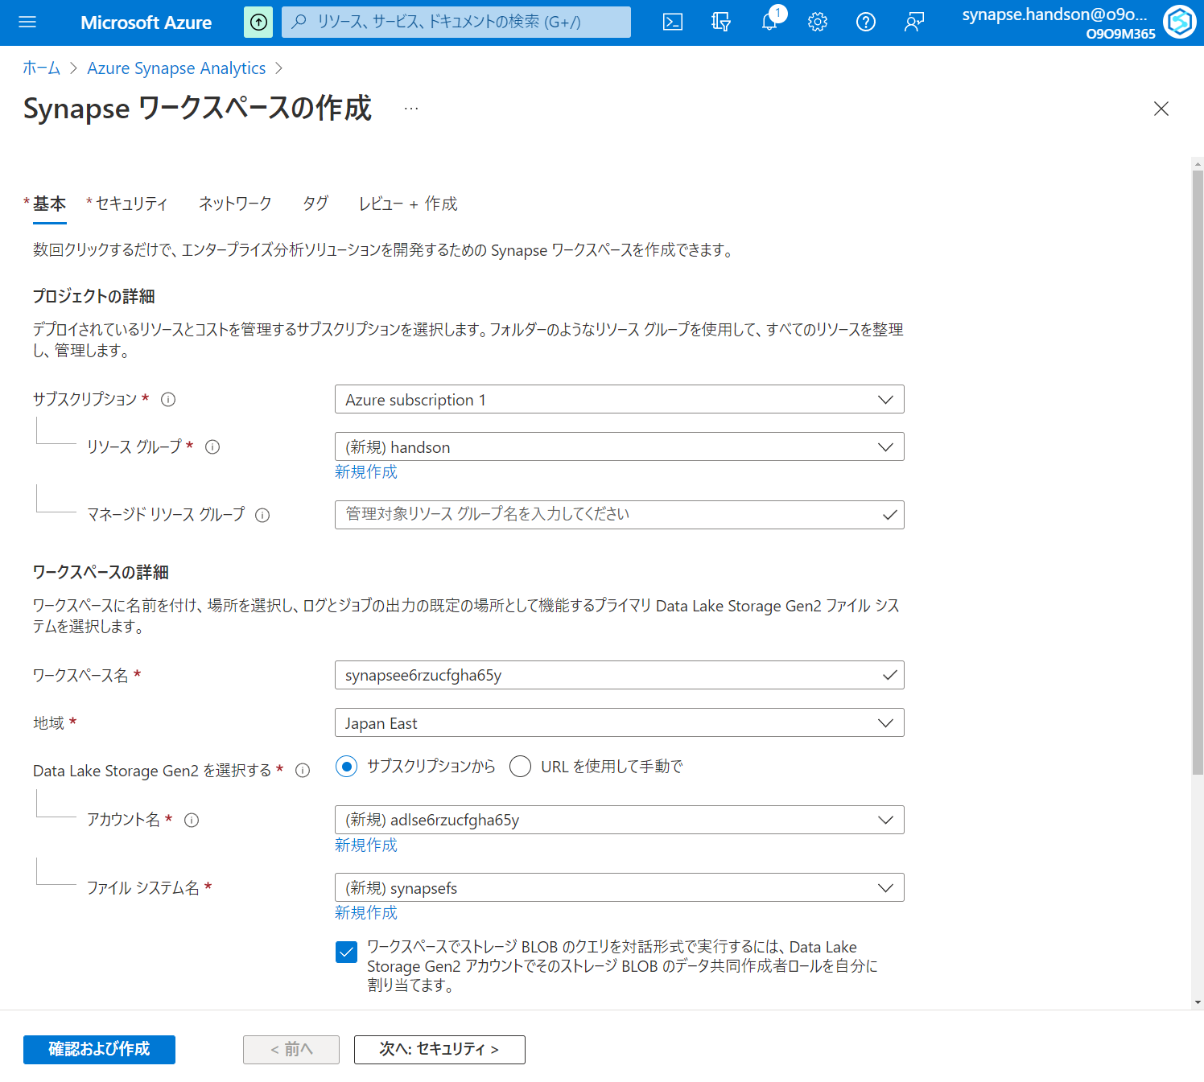

Slide 17
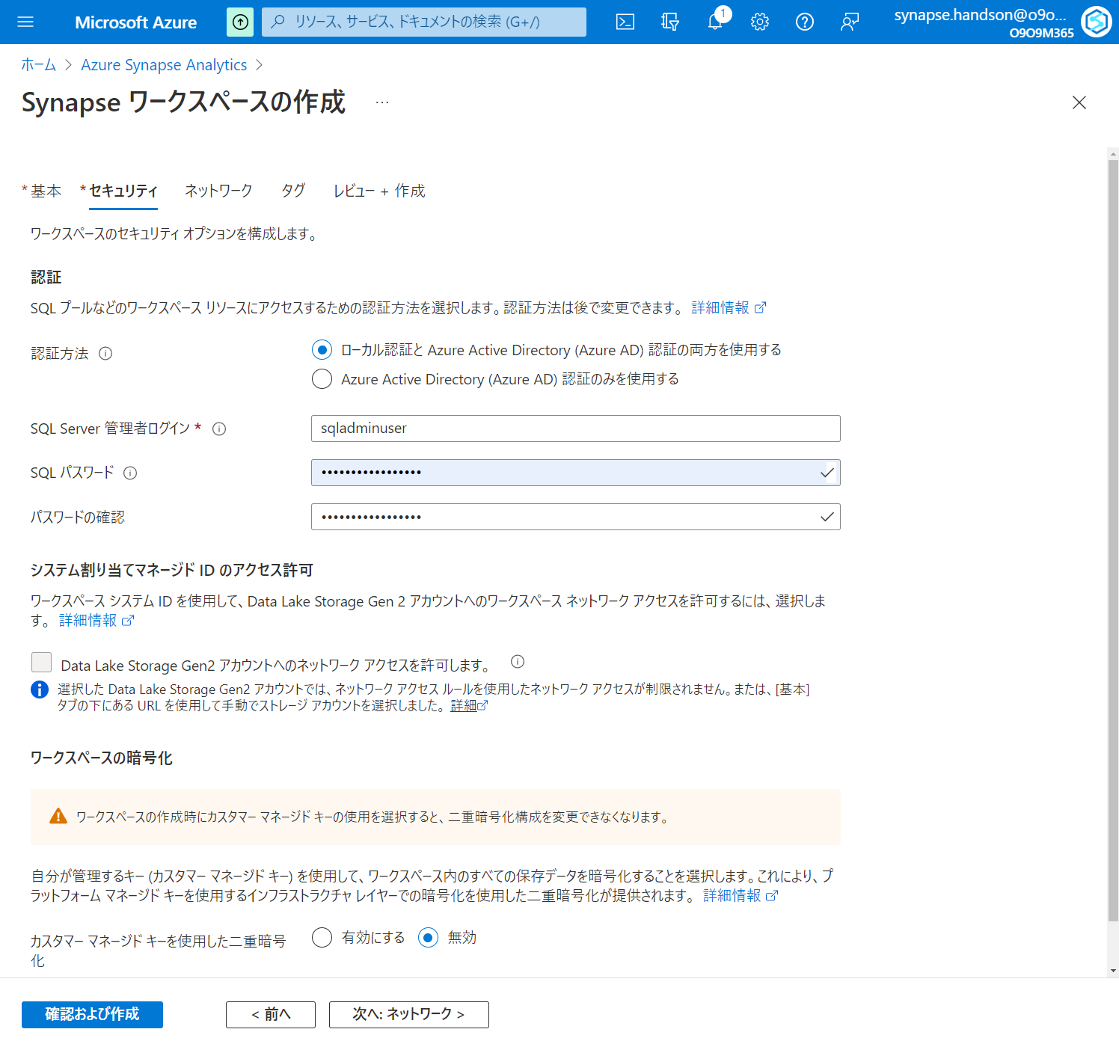

Slide 18
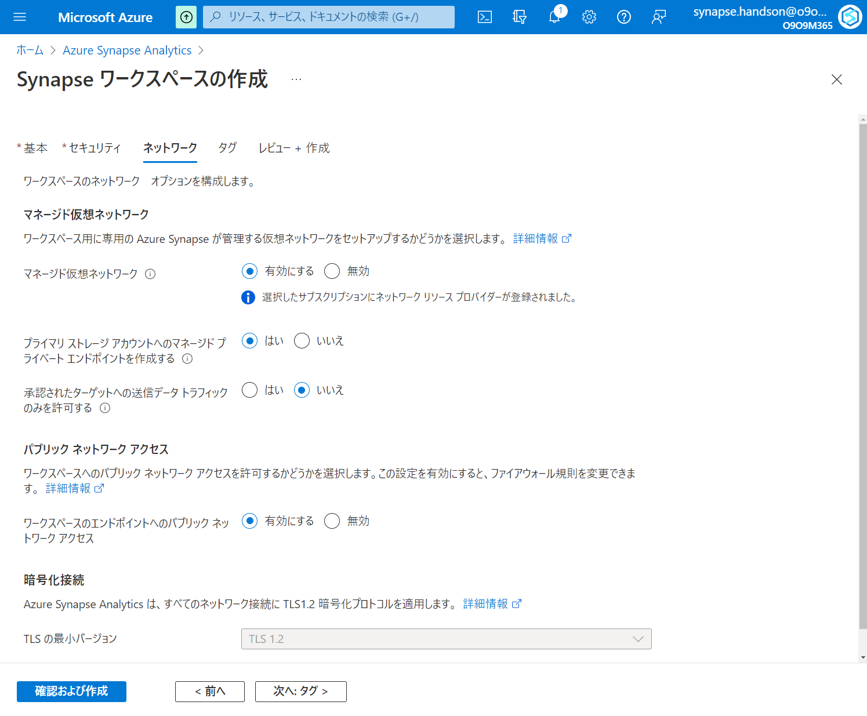

Slide 19
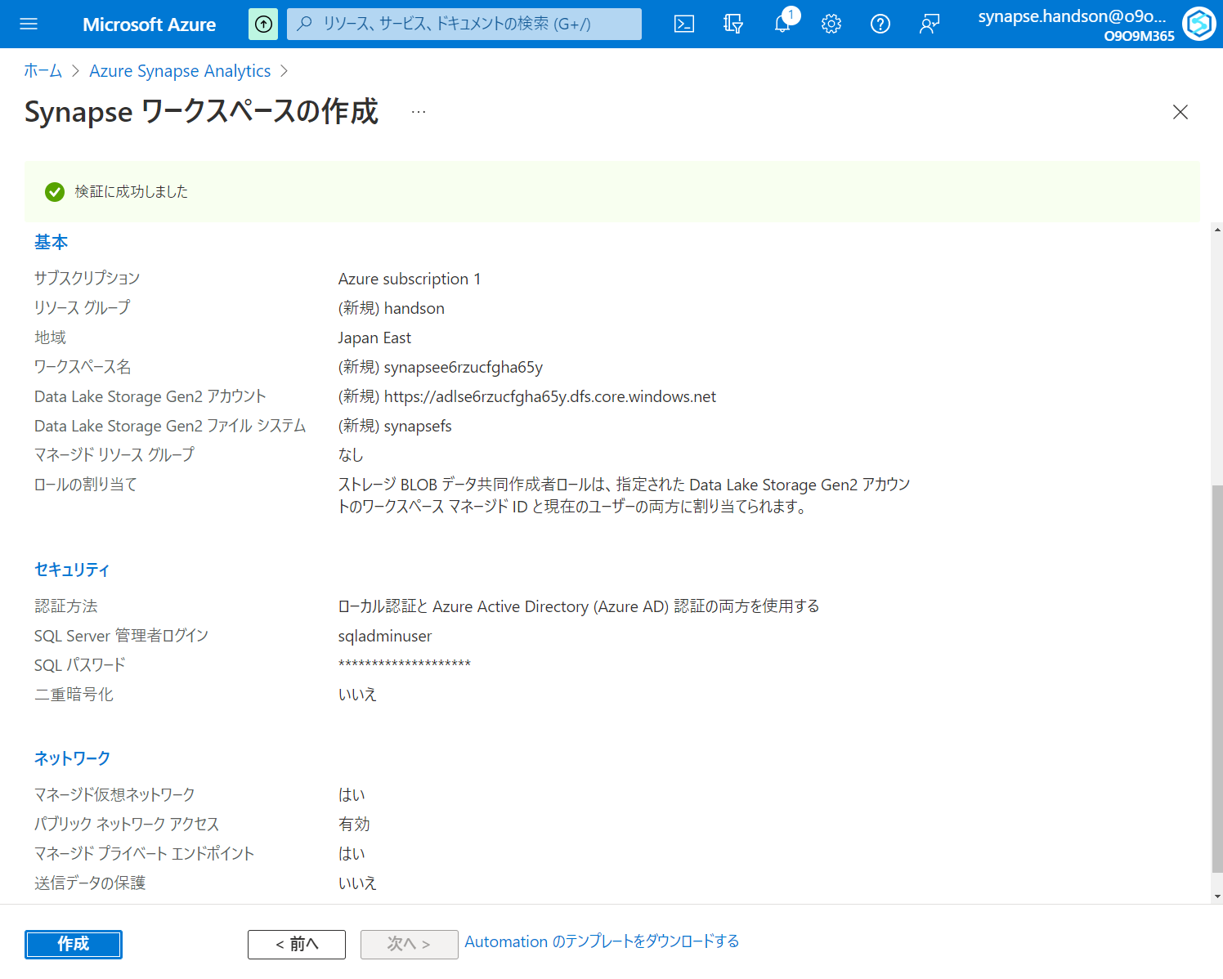

Slide 20
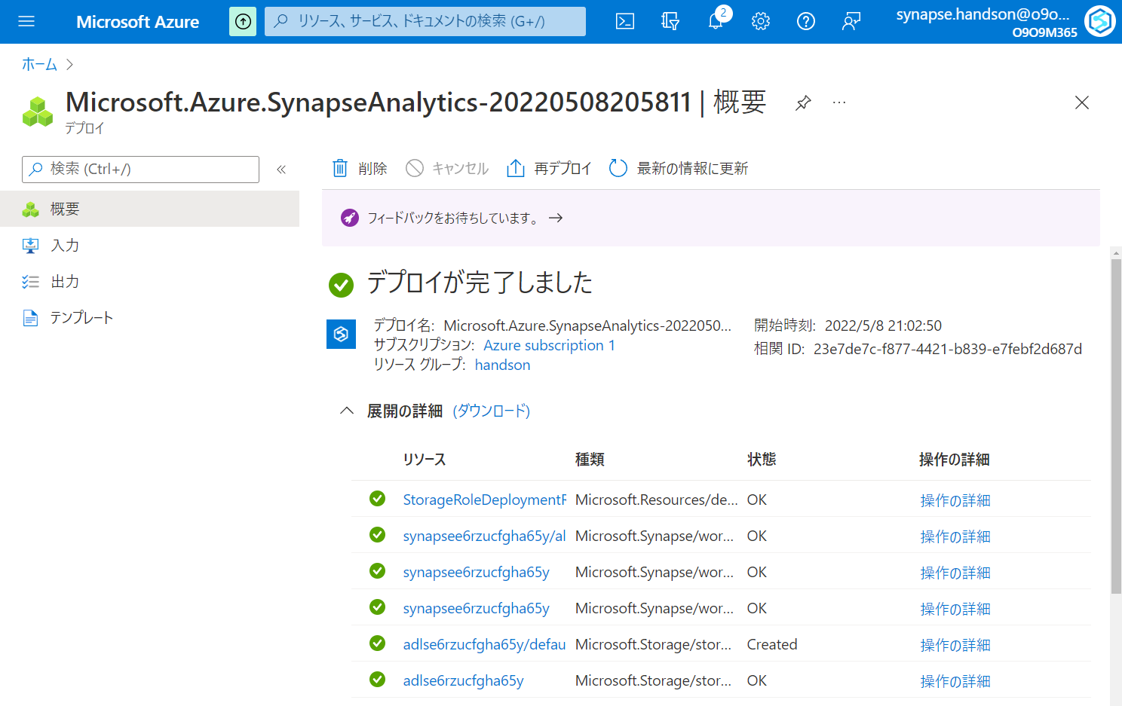

Slide 21
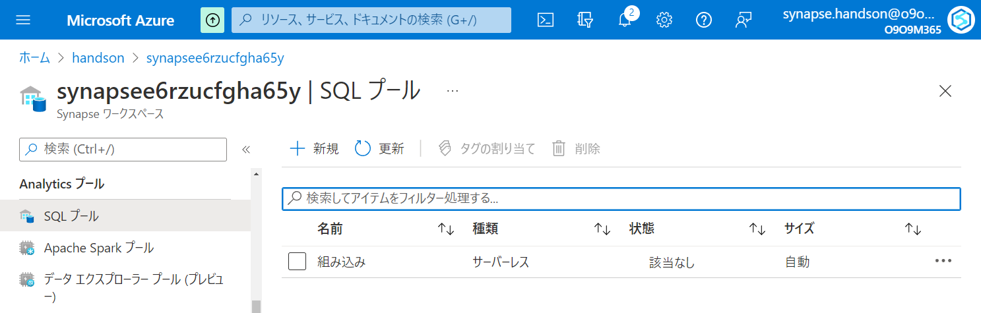

Slide 22
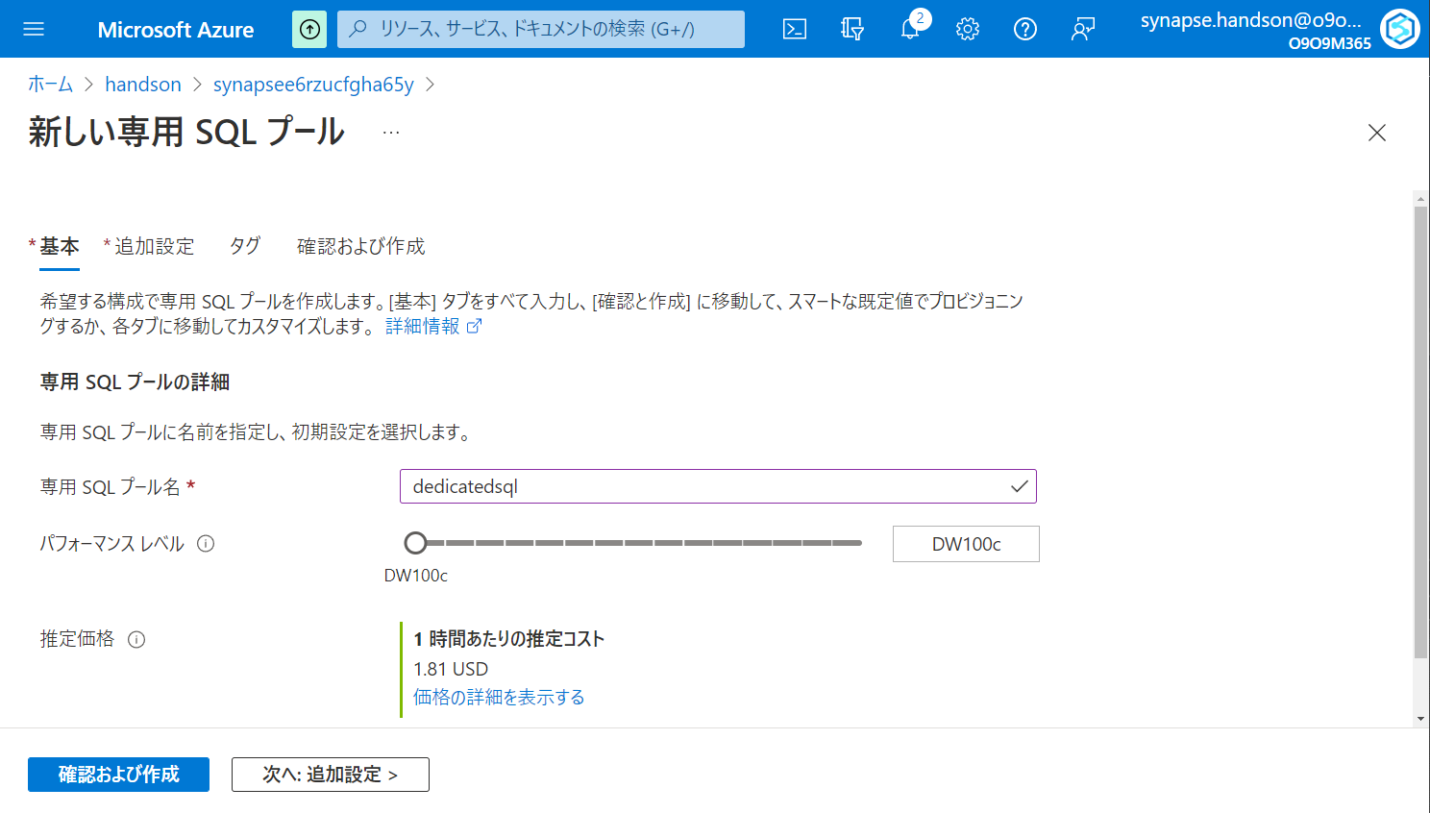

Slide 23
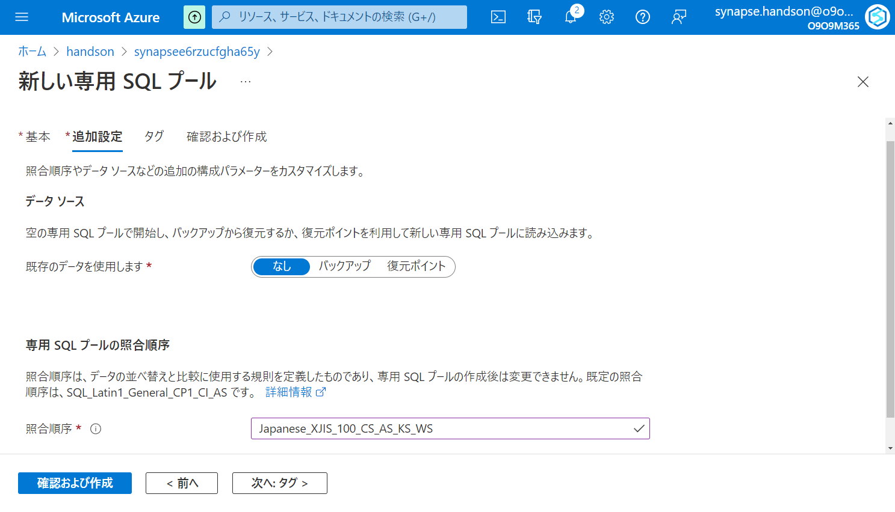

Slide 24
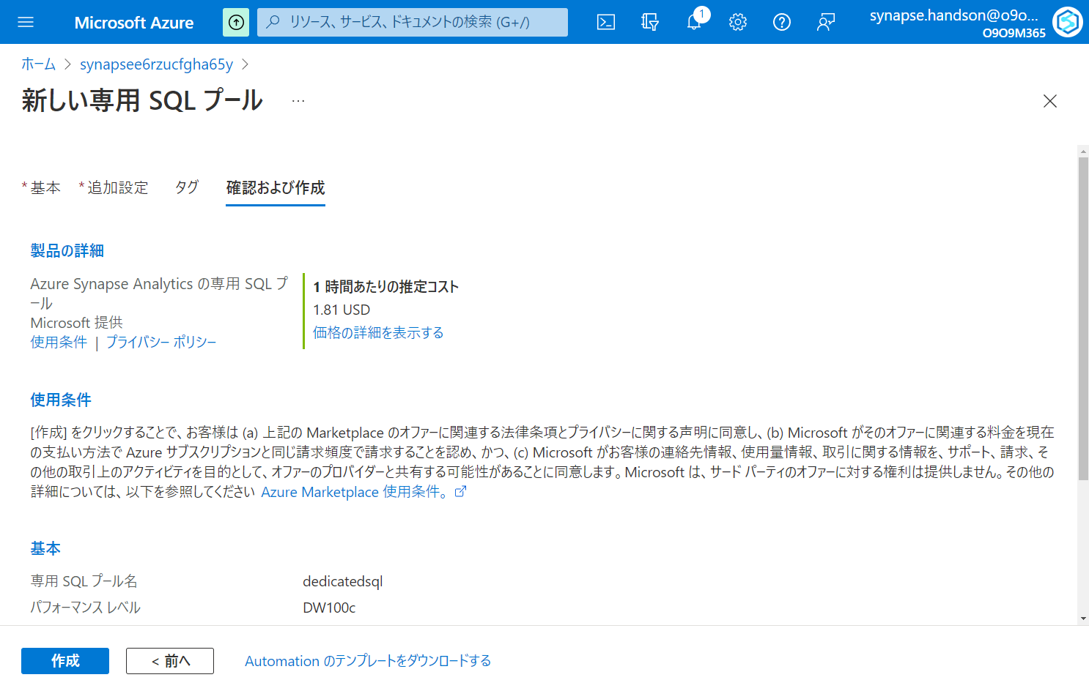

Slide 25
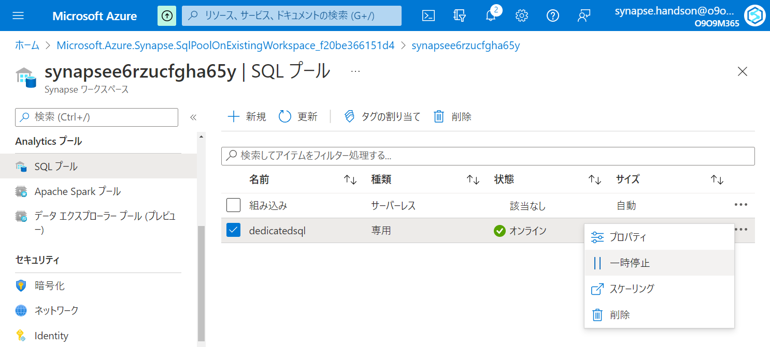

Slide 26
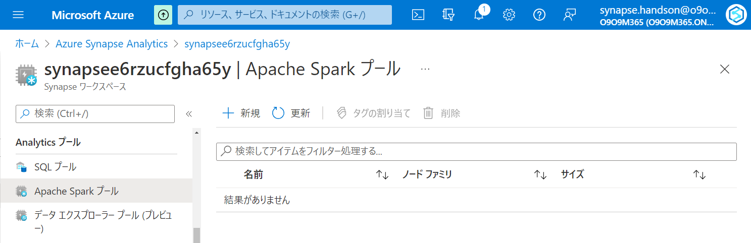

Slide 27
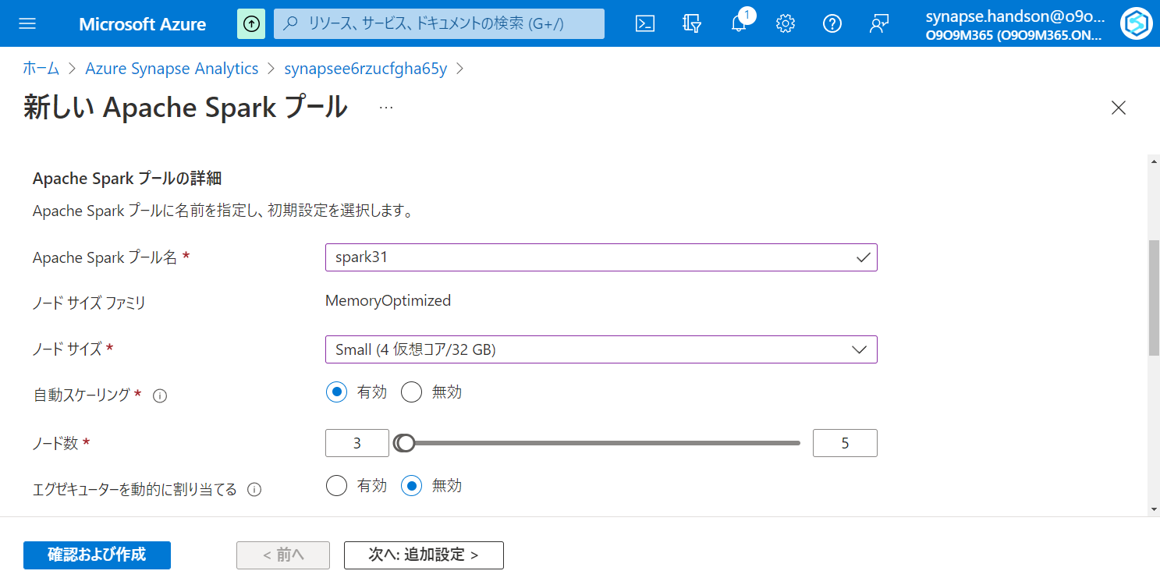

Slide 28
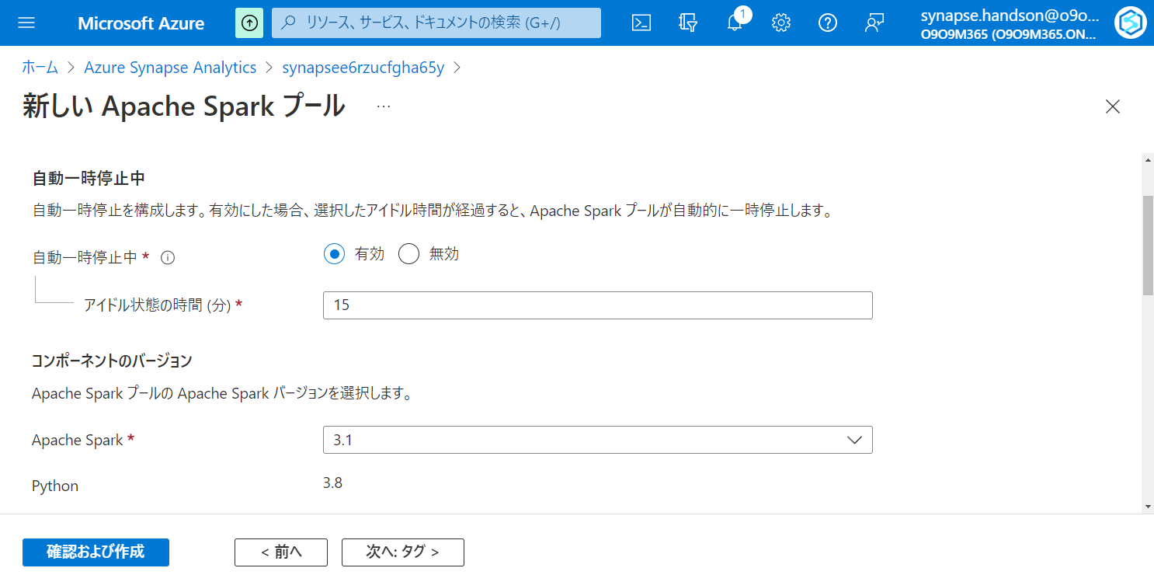

Slide 29
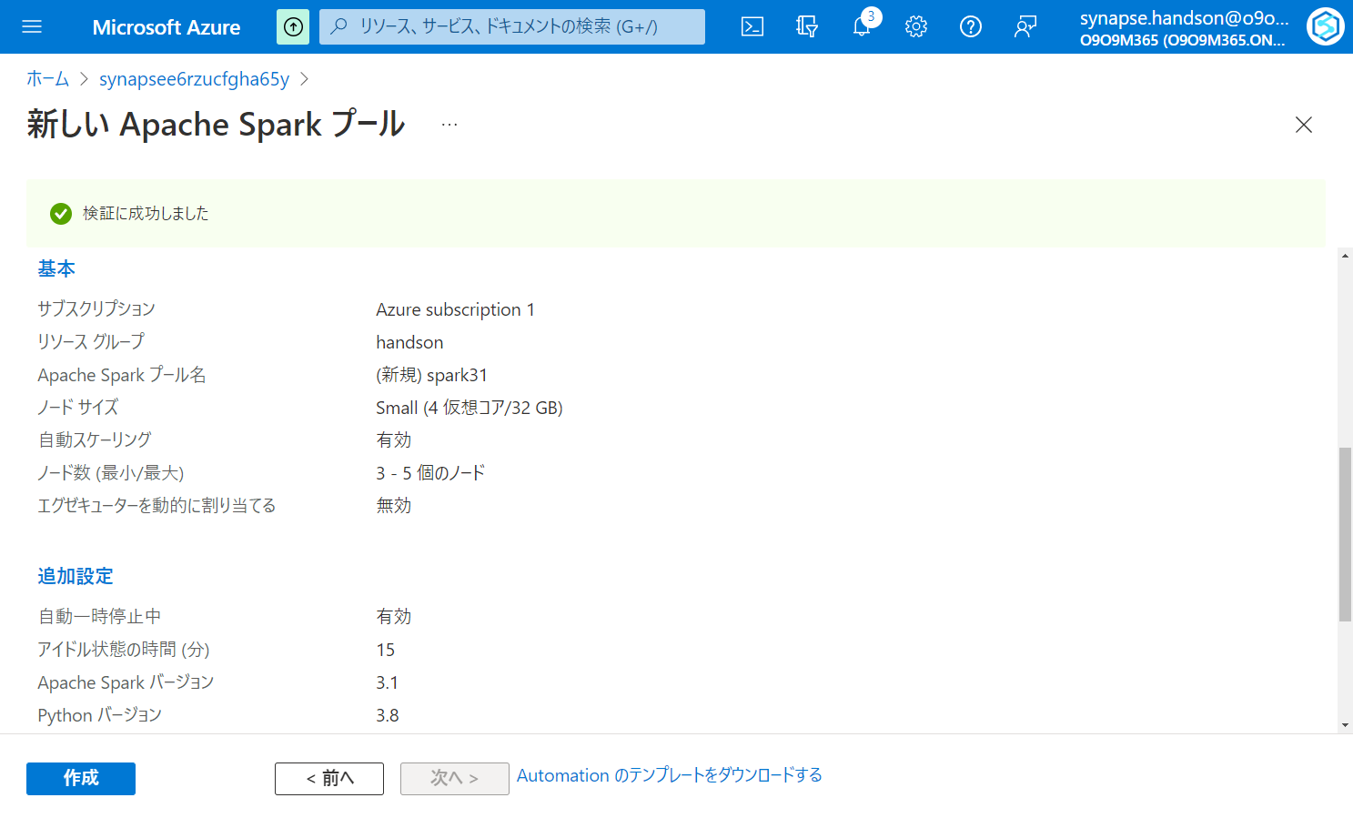

Slide 30
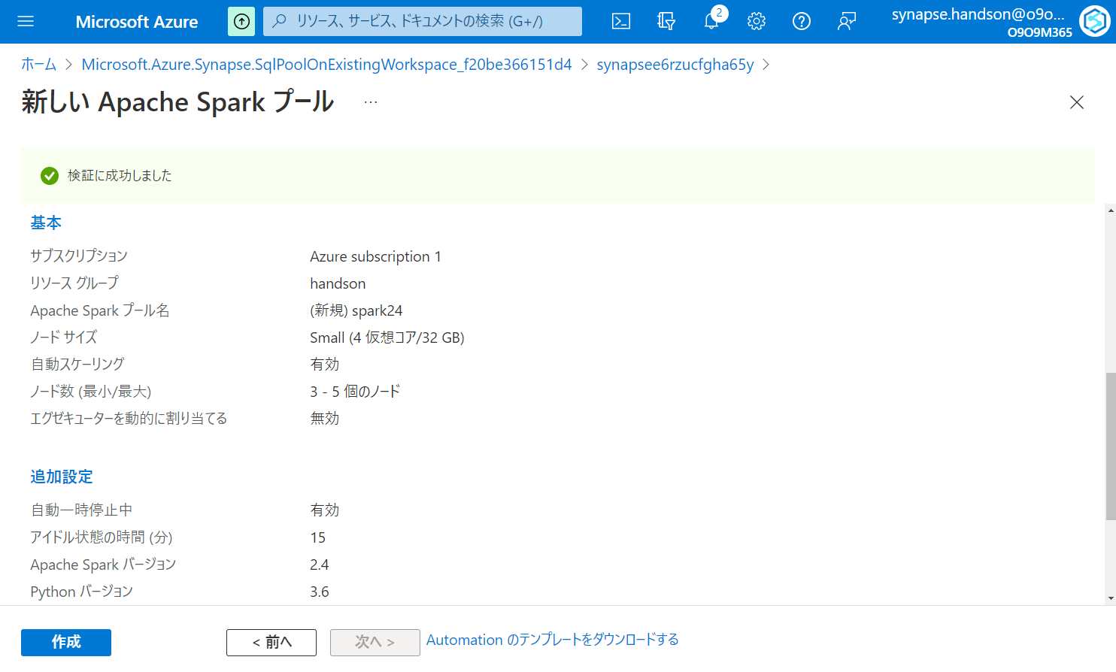

Slide 31
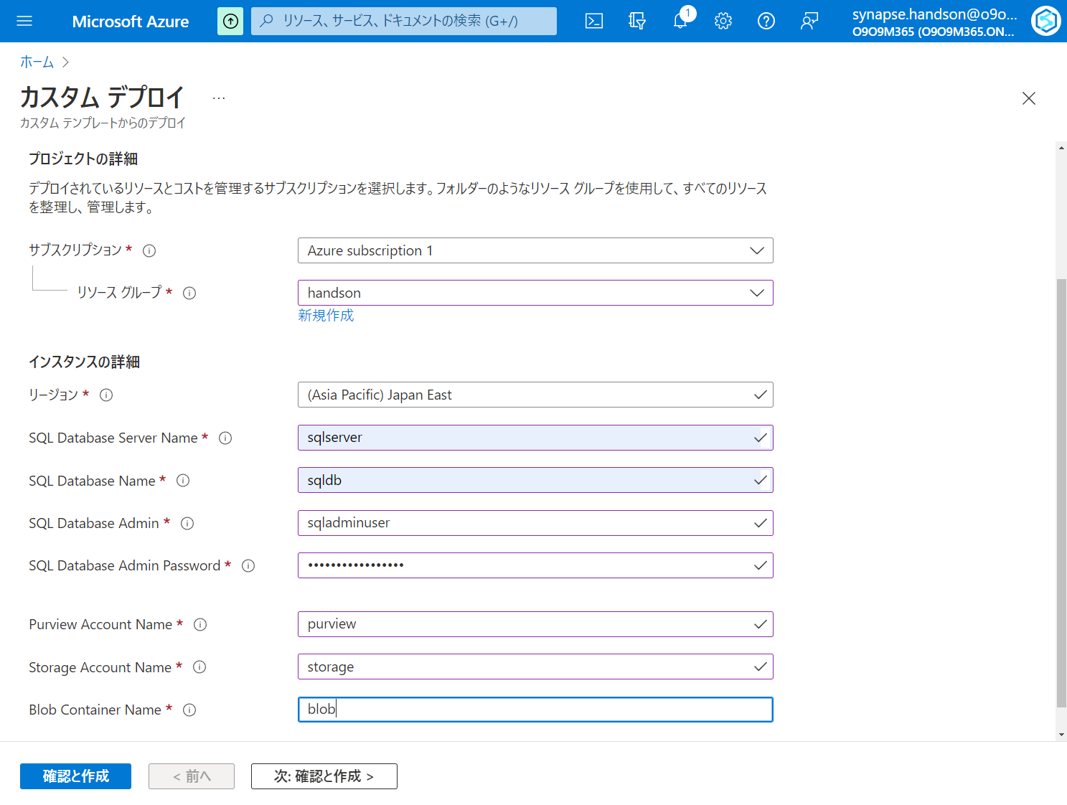

Slide 32
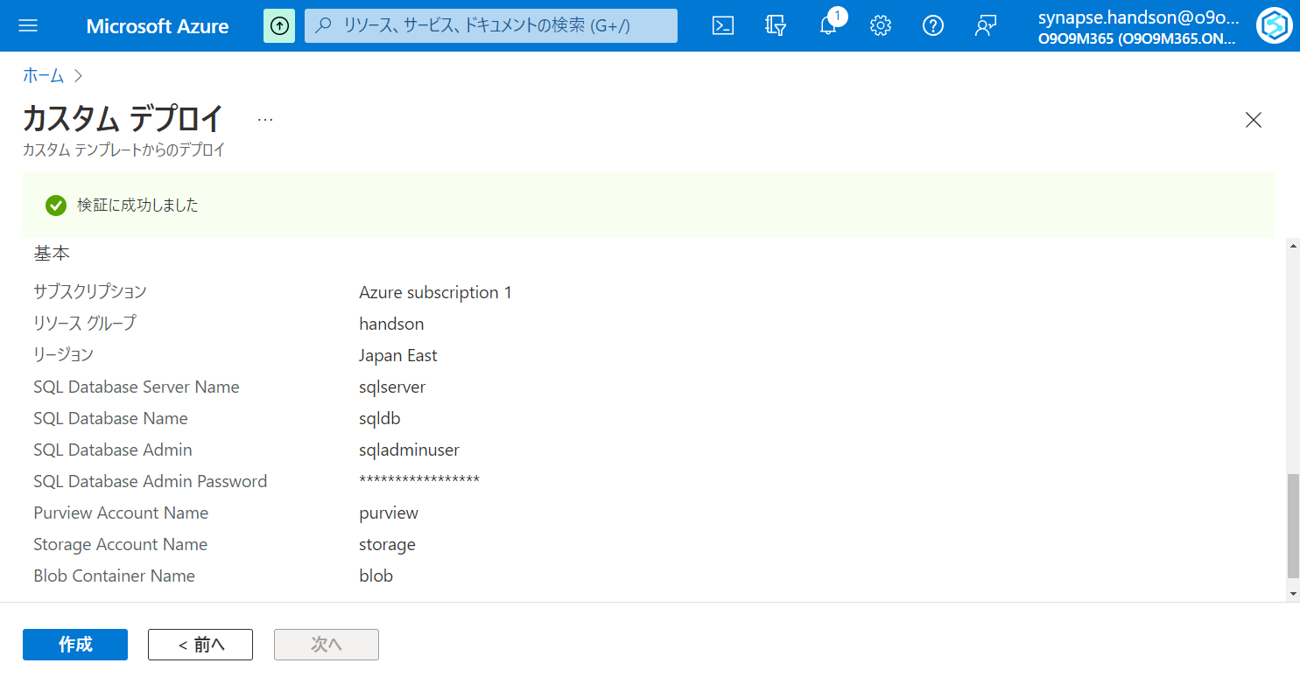

Slide 33
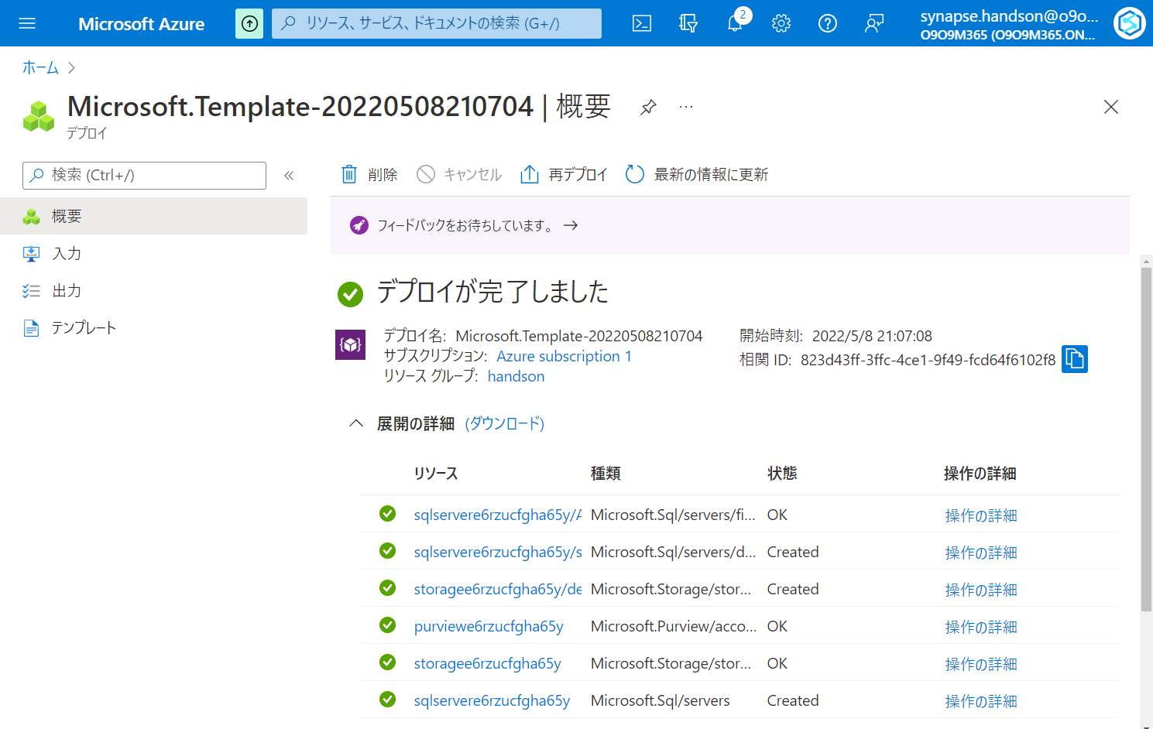

Slide 34
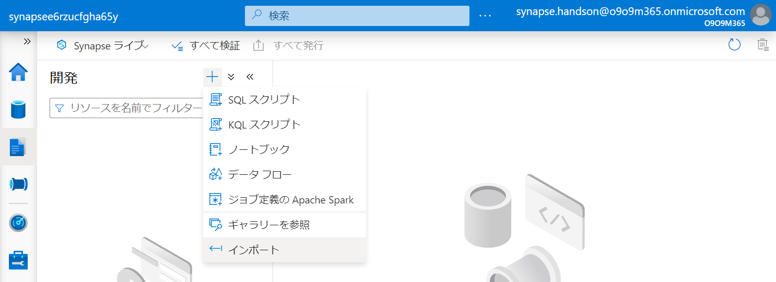

Slide 35
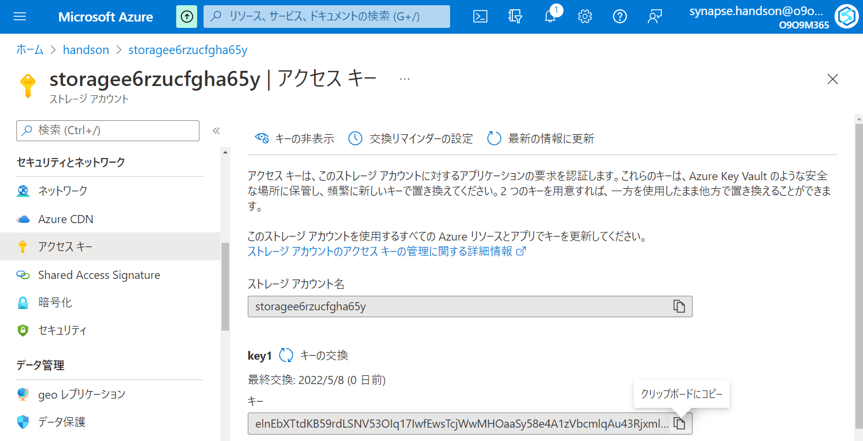

Slide 36
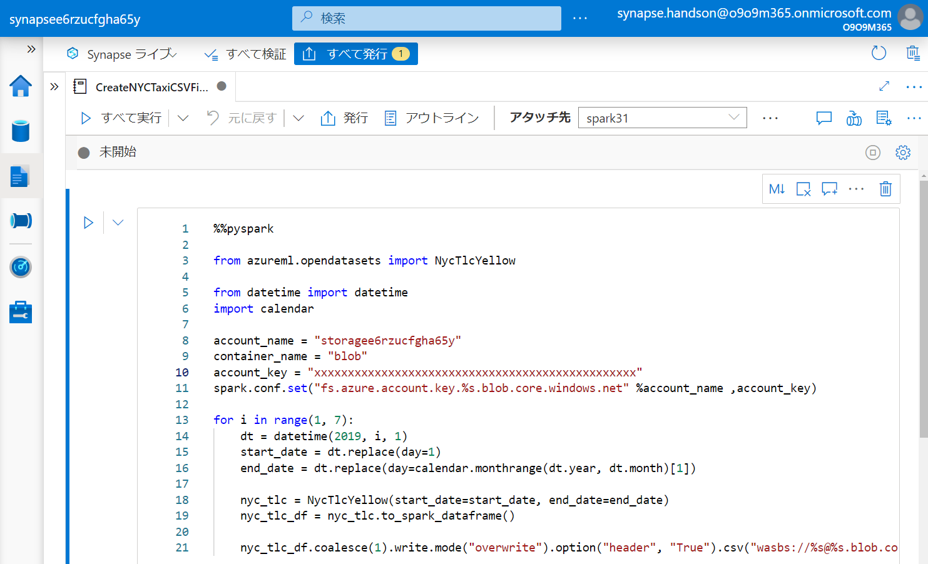

Slide 37
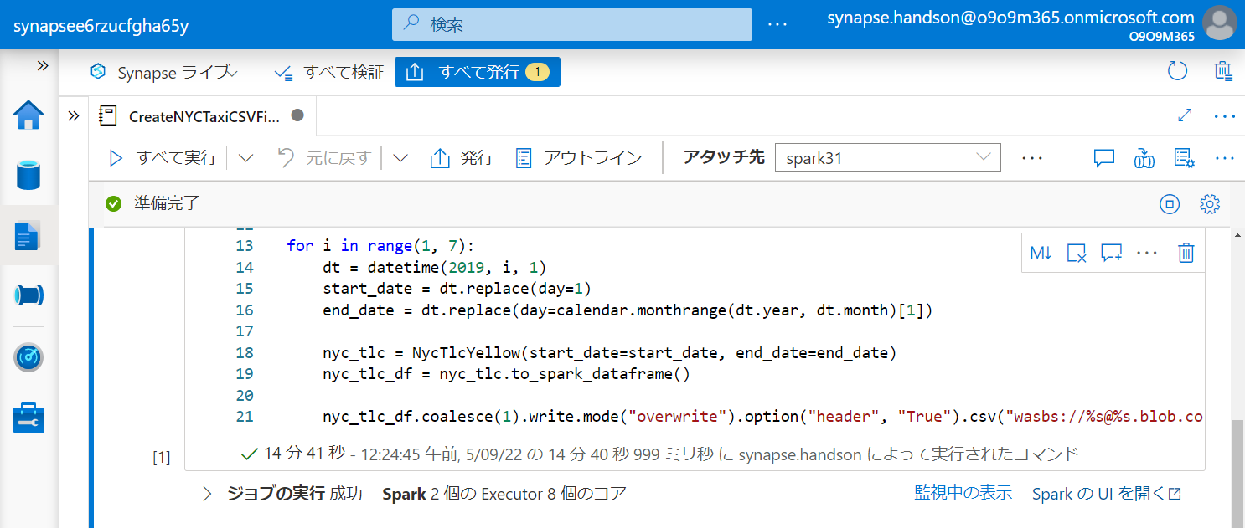

Slide 38
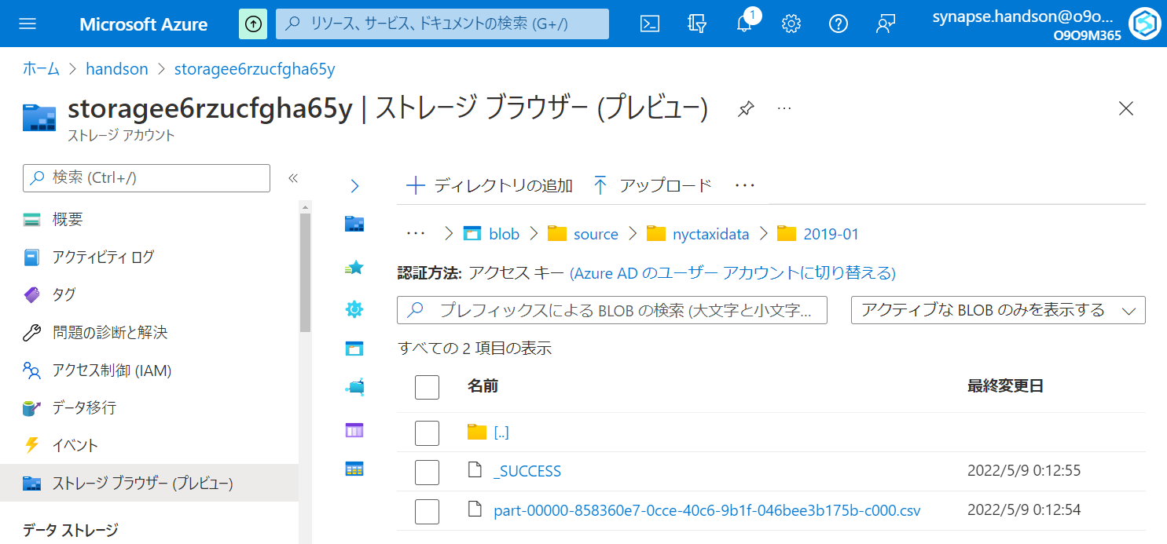

Slide 39
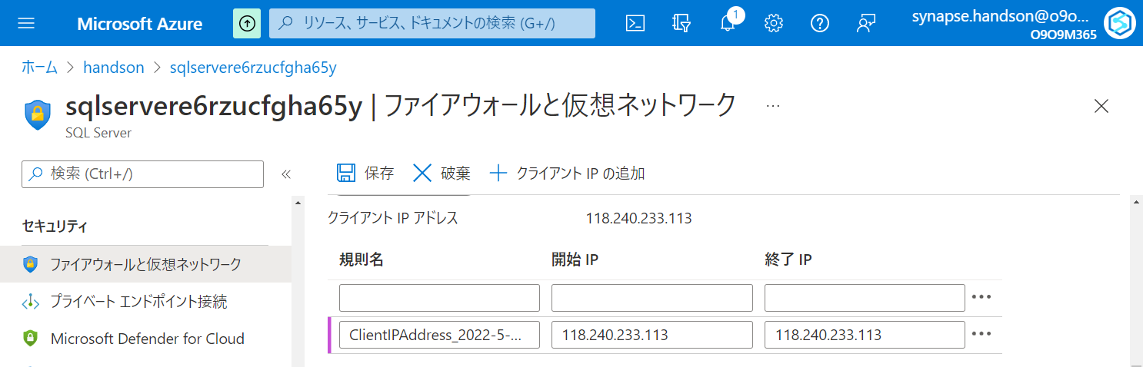

Slide 40
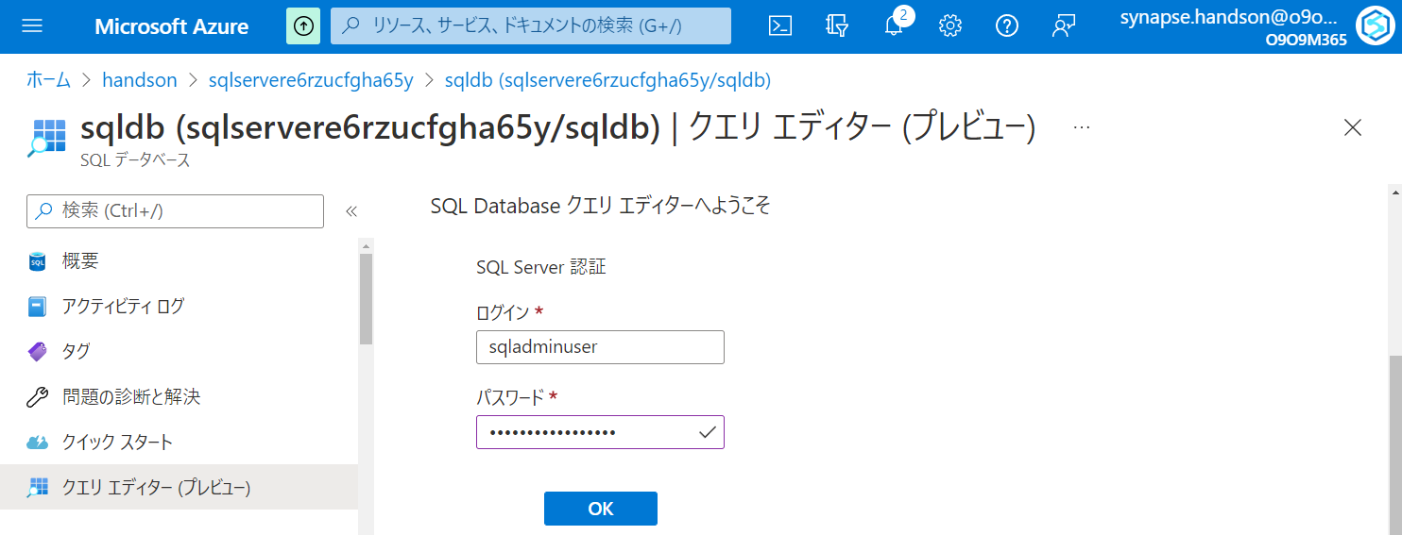

Slide 41
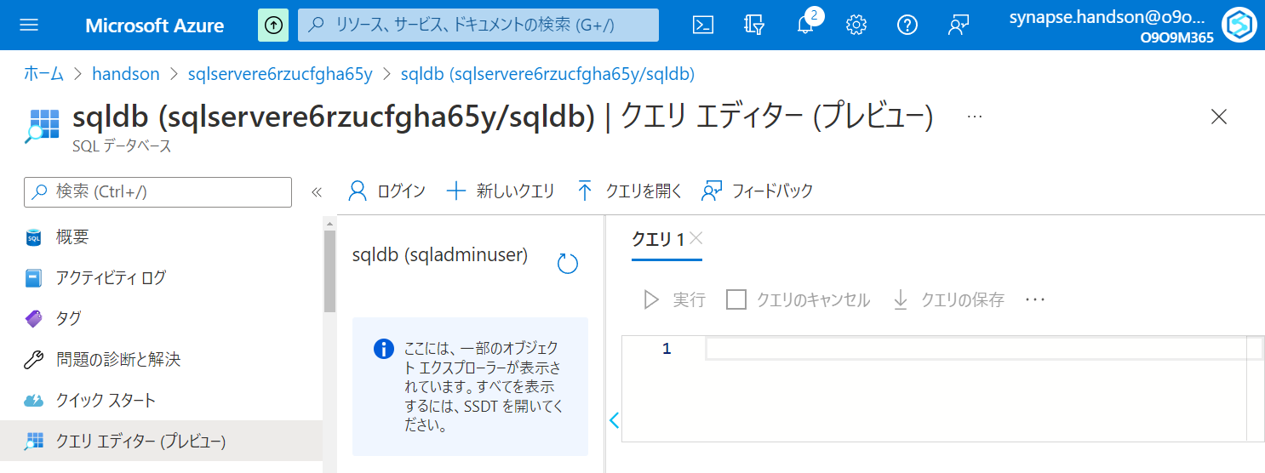

Slide 42
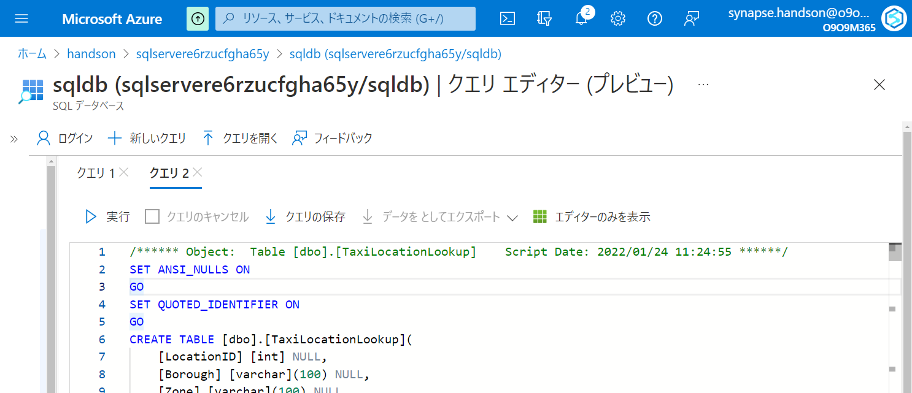

Slide 43
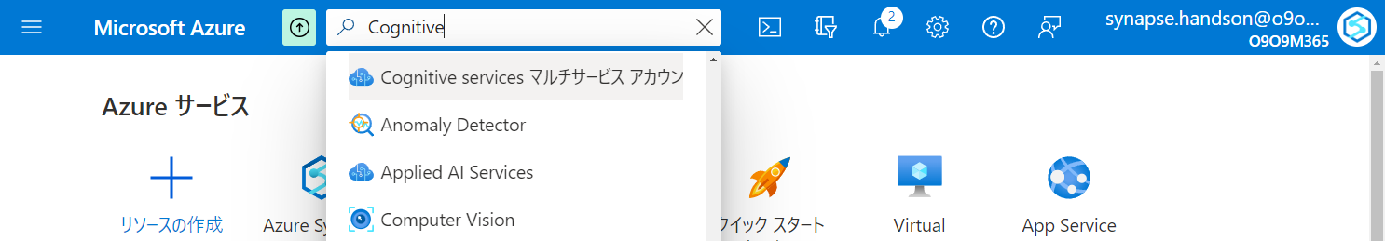

Slide 44
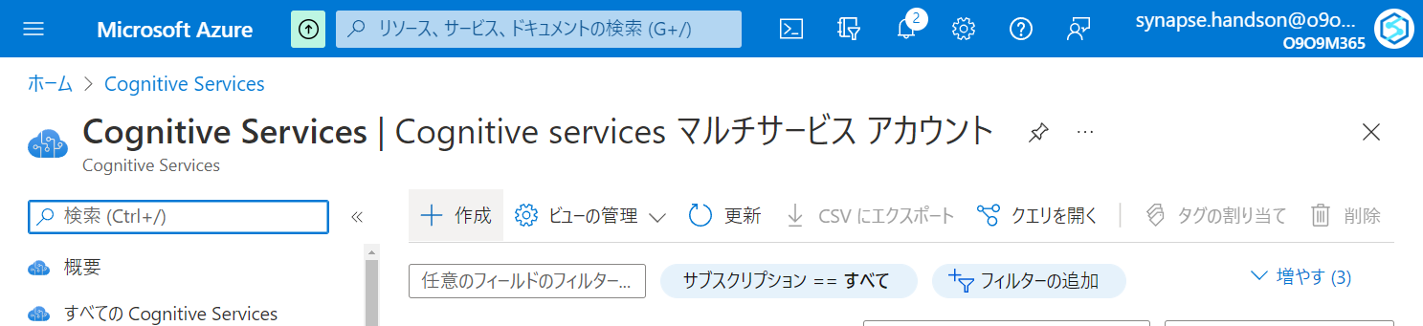

Slide 45
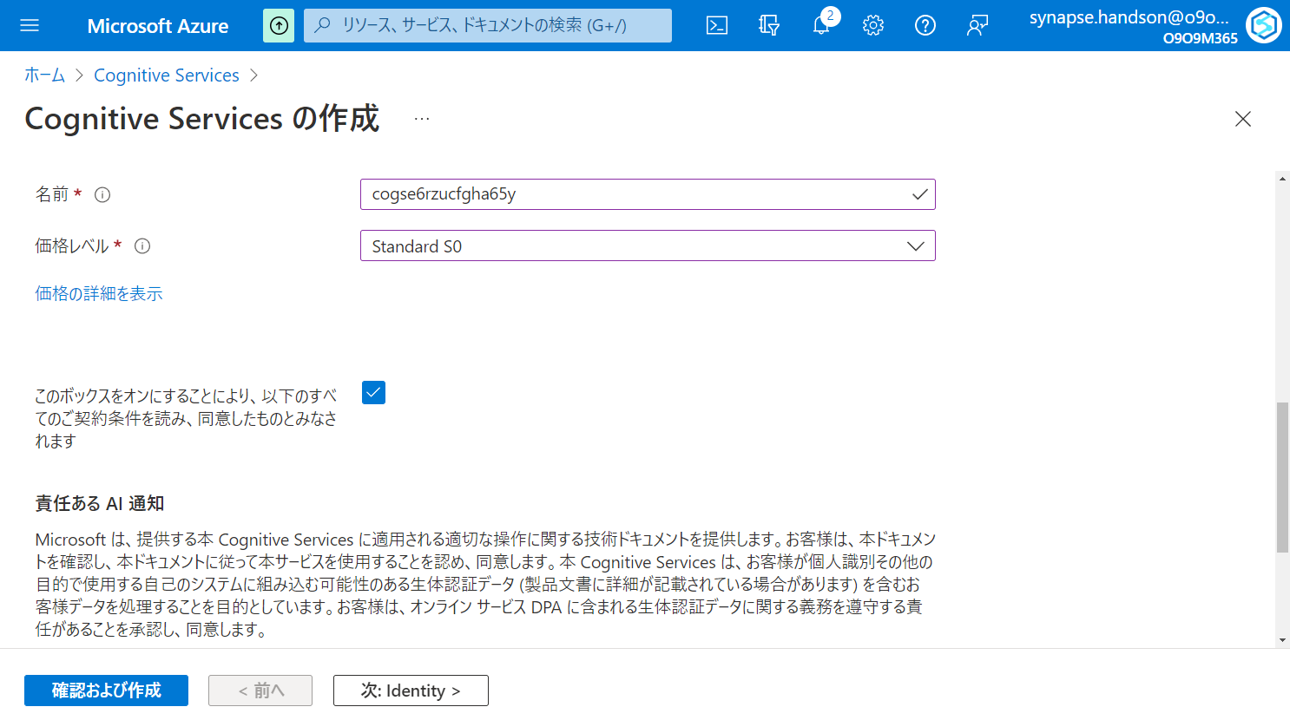

Slide 46
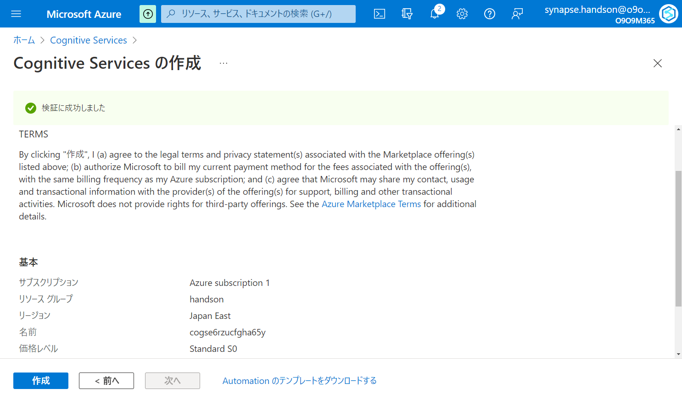

Slide 47
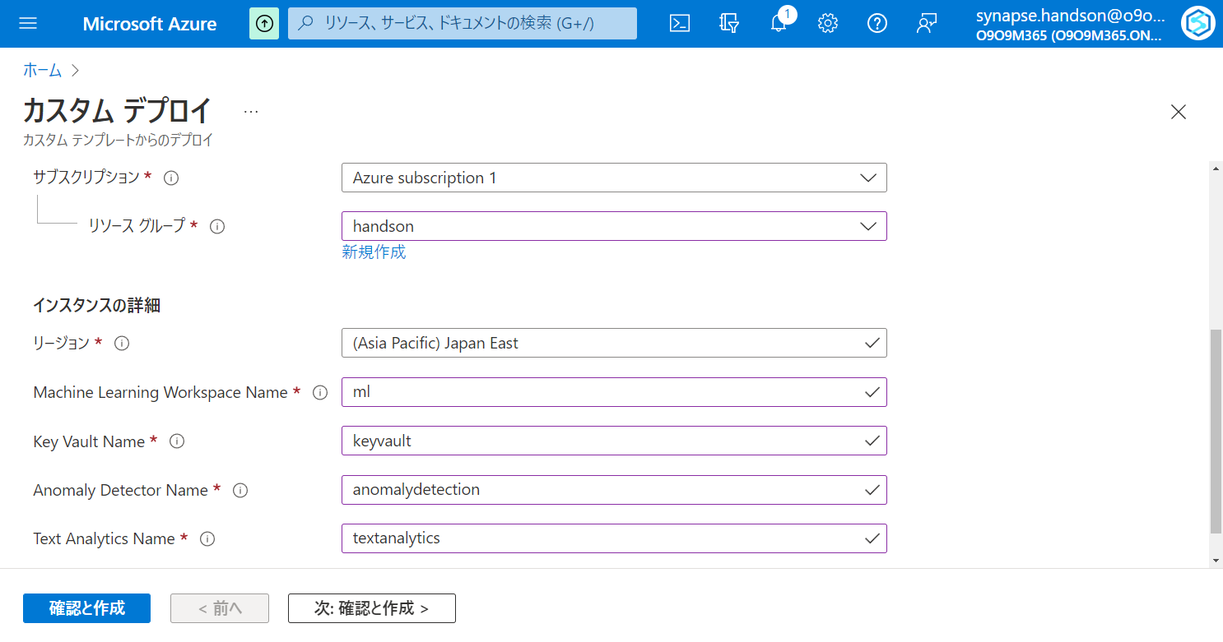

Slide 48
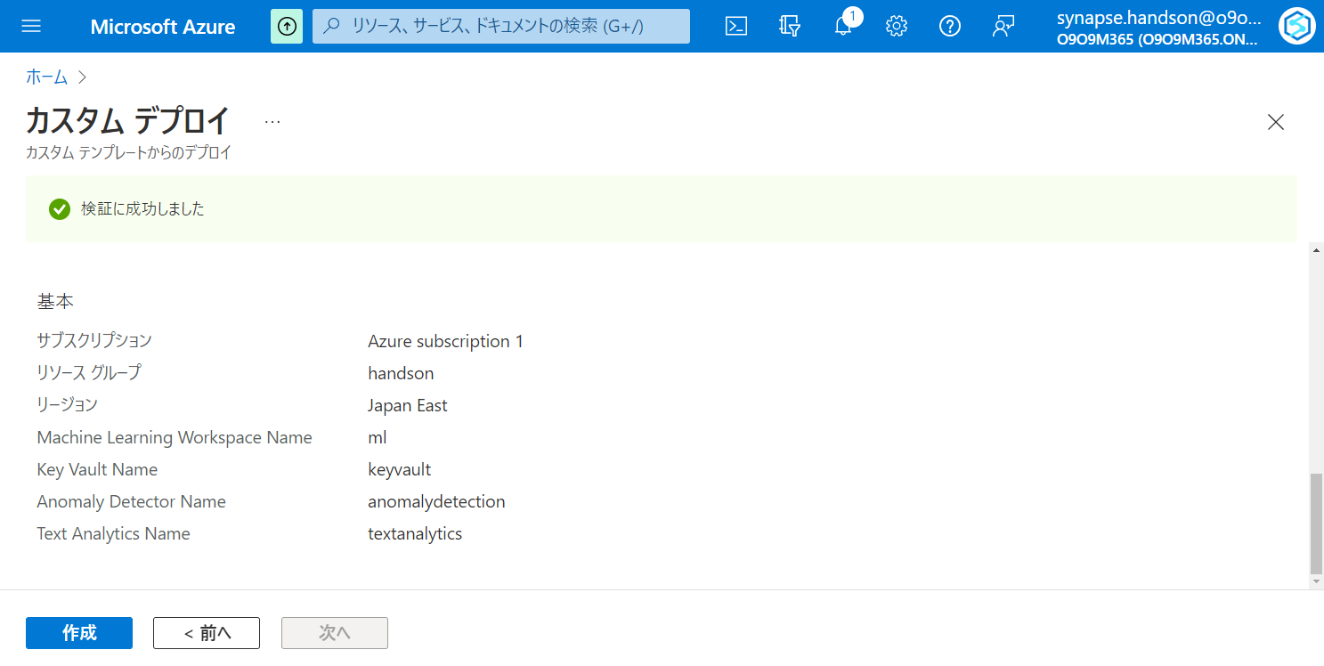

Slide 49
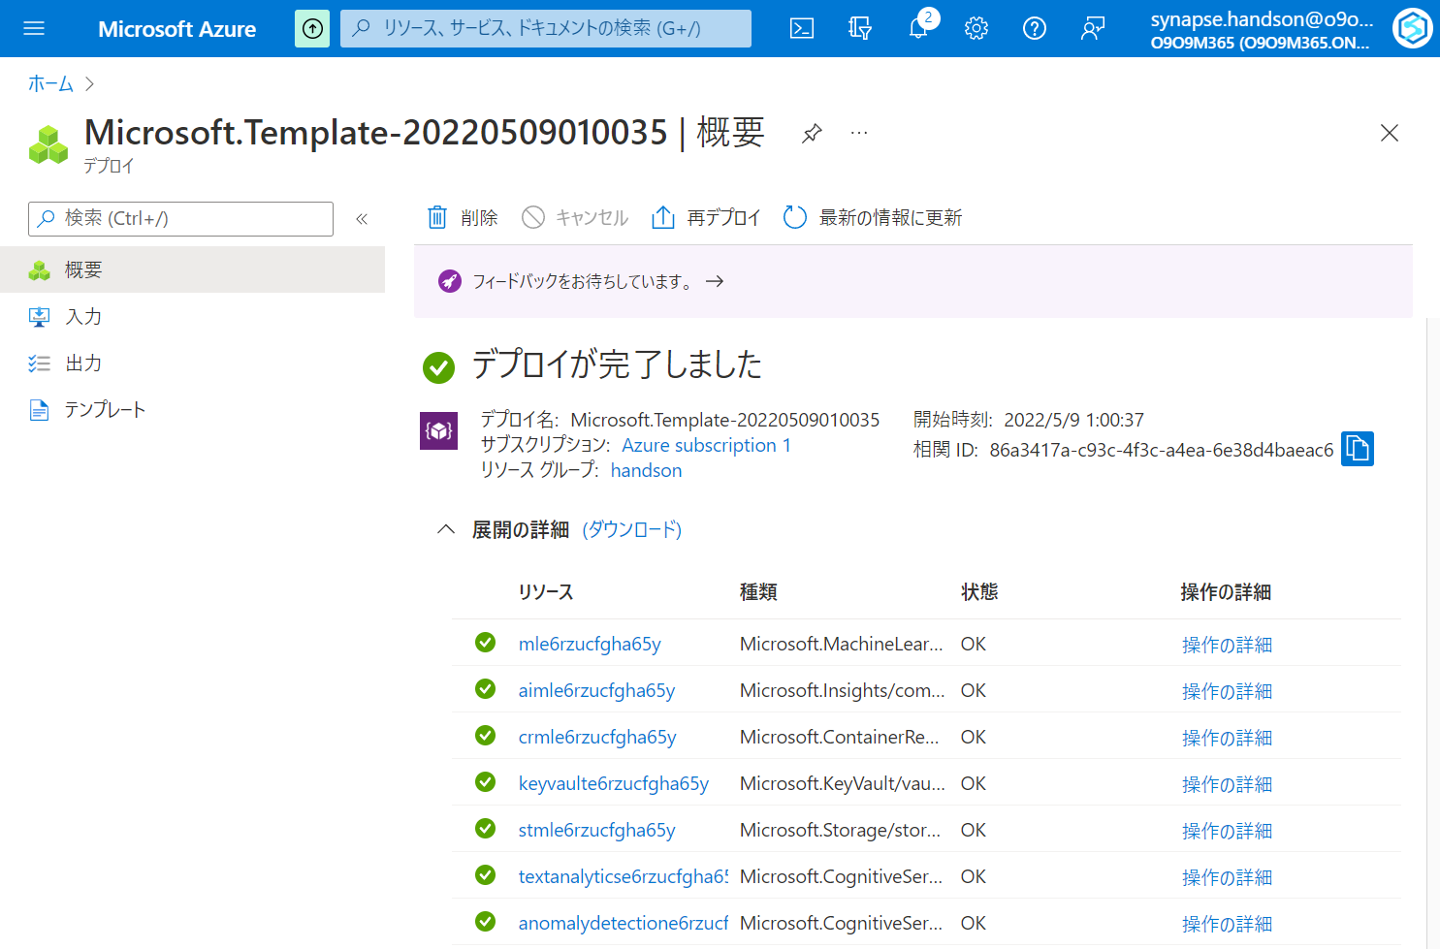

Slide 50
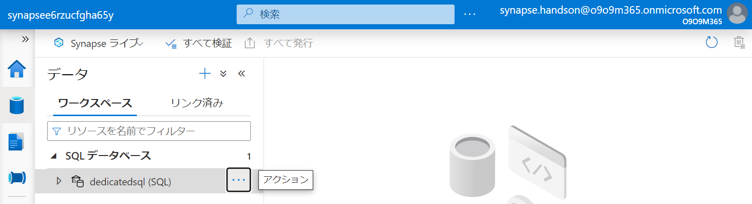

Slide 51
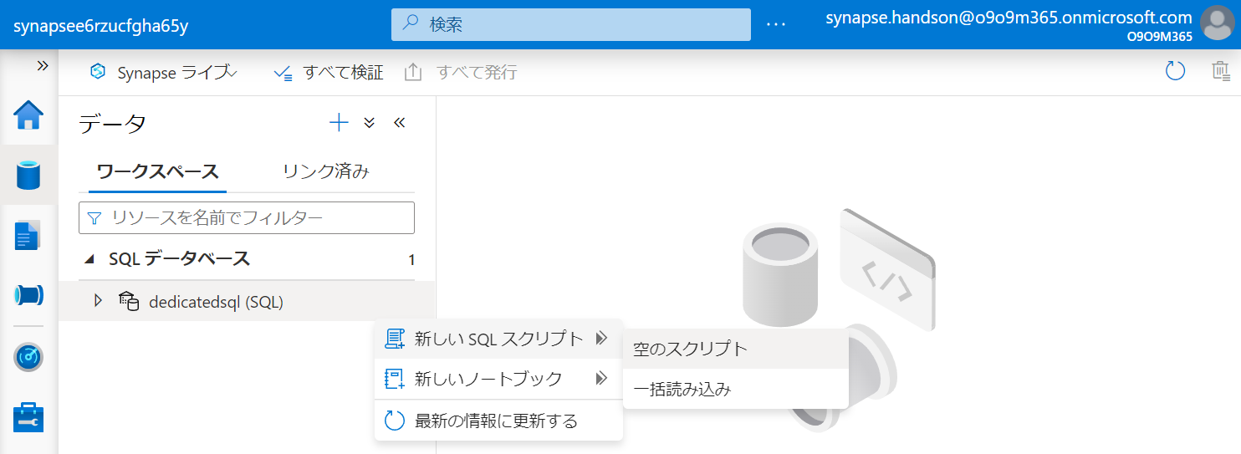

Slide 52
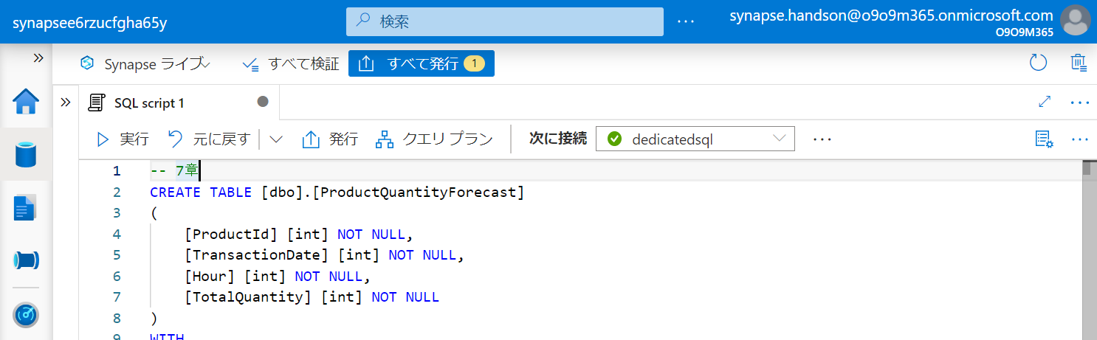

Slide 53
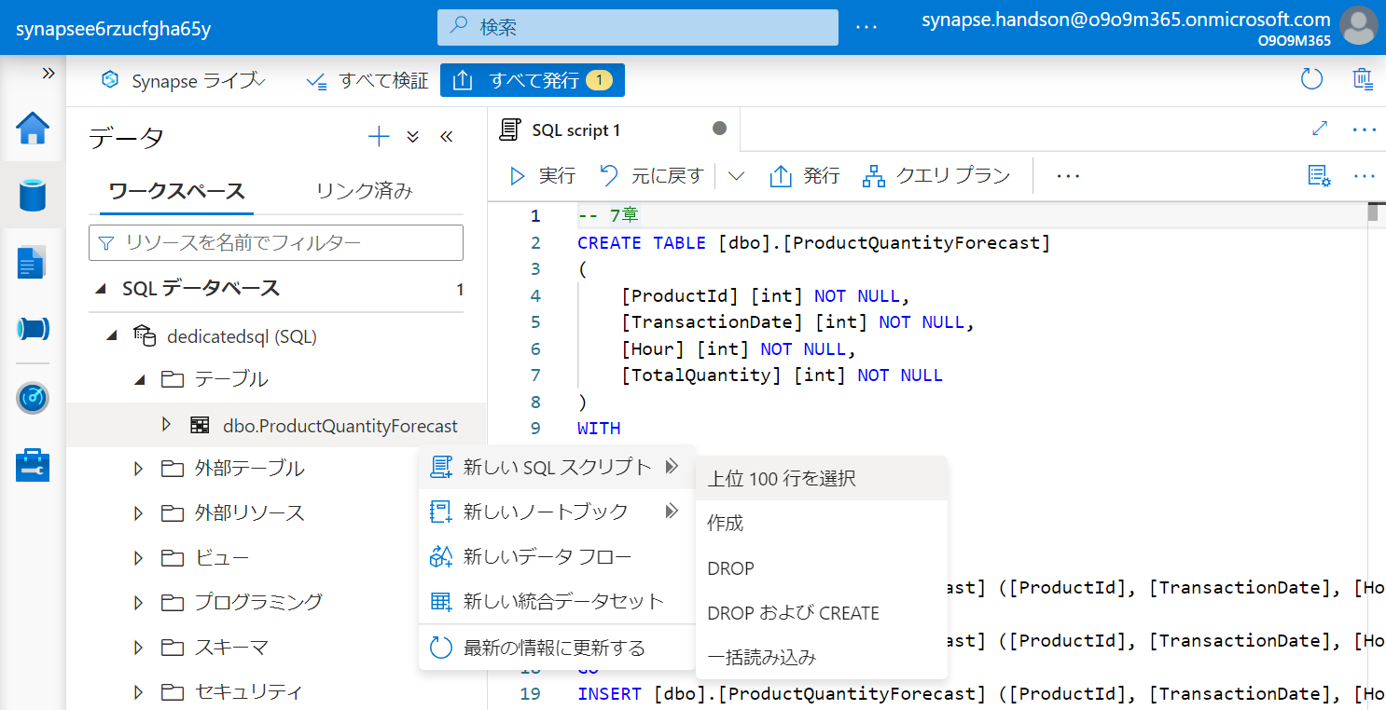

Slide 54


Slide 55


Slide 56


Slide 57


Slide 58


Slide 59


Slide 60


Slide 61


Slide 62


Slide 63


Slide 64


Slide 65


Slide 66


Slide 67


Slide 68


Slide 69


Slide 70


Slide 71


Slide 72
第5章：データの統合と可視化
Generate
Ingest
Store
Process
Enrich
Serve
Consume
On-Prems / Cloud
Realtime
Stream
Hot Path
IoT Hub
Batch
Functions
Power BI Premium
Dashboard
Event Hubs
Stream Analytics
Un/Semi -Structured
Cognitive Services
Analytics
SQL Database
Relational
Dedicated SQL
Data Explorer
Machine Learning
Cold Path
Dataflow
Cosmos DB
Data-driven Applications
Pipeline
NoSQL
Serverless Spark
Serverless SQL
HTAP with Synapse Link
Data Lake
Data Share
Shared Datasets
Discover & Govern
Azure Purview
Azure Active Directory
Azure Cost Management
Azure Key Vault
Azure Security Center
Platform
Azure Monitor
Azure DevOps
GitHub
Azure Policy

Slide 73


Slide 74


Slide 75


Slide 76


Slide 77
第6章：アドホックデータ探索とデータプレパレーション
Generate
Ingest
Store
Process
Enrich
Serve
Consume
On-Prems / Cloud
Realtime
Stream
Hot Path
IoT Hub
Batch
Functions
Power BI Premium
Dashboard
Event Hubs
Stream Analytics
Un/Semi -Structured
Cognitive Services
Analytics
SQL Database
Relational
Dedicated SQL
Data Explorer
Machine Learning
Cold Path
Dataflow
Cosmos DB
Data-driven Applications
Pipeline
NoSQL
Serverless Spark
Serverless SQL
HTAP with Synapse Link
Data Lake
Data Share
Shared Datasets
Discover & Govern
Azure Purview
Azure Active Directory
Azure Cost Management
Azure Key Vault
Azure Security Center
Platform
Azure Monitor
Azure DevOps
GitHub
Azure Policy

Slide 78
第7章：機械学習統合によるデータエンリッチメント
Generate
Ingest
Store
Process
Enrich
Serve
Consume
On-Prems / Cloud
Realtime
Stream
Hot Path
IoT Hub
Batch
Functions
Power BI Premium
Dashboard
Event Hubs
Stream Analytics
Un/Semi -Structured
Cognitive Services
Analytics
SQL Database
Relational
Dedicated SQL
Data Explorer
Machine Learning
Cold Path
Dataflow
Cosmos DB
Data-driven Applications
Pipeline
NoSQL
Serverless Spark
Serverless SQL
HTAP with Synapse Link
Data Lake
Data Share
Shared Datasets
Discover & Govern
Azure Purview
Azure Active Directory
Azure Cost Management
Azure Key Vault
Azure Security Center
Platform
Azure Monitor
Azure DevOps
GitHub
Azure Policy

Slide 79


Slide 80


Slide 81
第8章：リアルタイムデータ分析
Generate
Ingest
Store
Process
Enrich
Serve
Consume
On-Prems / Cloud
Realtime
Stream
Hot Path
IoT Hub
Batch
Functions
Power BI Premium
Dashboard
Event Hubs
Stream Analytics
Un/Semi -Structured
Cognitive Services
Analytics
SQL Database
Relational
Dedicated SQL
Data Explorer
Machine Learning
Cold Path
Dataflow
Cosmos DB
Data-driven Applications
Pipeline
NoSQL
Serverless Spark
Serverless SQL
HTAP with Synapse Link
Data Lake
Data Share
Shared Datasets
Discover & Govern
Azure Purview
Azure Active Directory
Azure Cost Management
Azure Key Vault
Azure Security Center
Platform
Azure Monitor
Azure DevOps
GitHub
Azure Policy

Slide 82


Slide 83


Slide 84


Slide 85


Slide 86


Slide 87


Slide 88


Slide 89


Slide 90


Slide 91


Slide 92


Slide 93

不要

Slide 94

不要

Slide 95

不要

Slide 96

不要

Slide 97


Slide 98


Slide 100


Slide 101



Slide 102


Slide 104


Slide 106


Slide 107


Slide 108


Slide 109


Slide 110


Slide 111


Slide 112


Slide 113


Slide 114


Slide 115


Slide 116


Slide 117


Slide 118


Slide 119


Slide 120


Slide 121


Slide 123


Slide 124


Slide 125


Slide 126


Slide 127


Slide 128


Slide 130


Slide 131


Slide 132


Slide 133


Slide 134


Slide 135

右クリック

Slide 136


Slide 138


Slide 139


Slide 140


Slide 142


Slide 143


Slide 144


Slide 145


Slide 146


Slide 147


Slide 148


Slide 149


Slide 150


Slide 151


Slide 152

ドラッグ&ドロップ

Slide 153

ドラッグ&ドロップ

Slide 154


Slide 155


Slide 156

5-2-2-1

Slide 157

5-2-2-1

Slide 158

5-2-2-2

Slide 159

5-2-2-2

Slide 160

5-2-2-2
右クリック

Slide 161

5-2-2-2

Slide 162

5-3-1-1

Slide 163

5-3-1-1

Slide 164

5-3-1-2

Slide 165

5-3-1-2

Slide 166

5-3-1-2

Slide 167

5-3-1-2

Slide 168

5-3-1-2

Slide 169

5-3-1-2

Slide 170

5-3-1-2

Slide 171

5-3-1-2

Slide 172

5-3-1-2

Slide 173

5-3-1-2

Slide 174

5-3-1-2

Slide 175

5-3-1-2
Column Name | Expression
PickUpDate | toDate(tpep_pickup_datetime,'yyyy-MM-dd')
PickUpLocationID | toInteger(PULocationID)
PassengerCount | toInteger(passenger_count)
DistanceTravelled | toDecimal(trip_distance)
TipAmount | toDecimal(tip_amount)
FareAmount | toDecimal(fare_amount)
TotalAmount | toDecimal(total_amount)

Slide 176

5-3-1-2

Slide 177

5-3-1-2

Slide 178

5-3-1-2
- Join Settings > Output stream name: JoinPickUpLocation - Join Settings > Left stream: TransformColumns - Join Settings > Right stream: TaxiLocationLookup - Join Settings > Join type: Inner - Join Settings > Join conditions > Left: PickUpLocationID - Join Settings > Join conditions > Right: LocationID

Slide 179

5-3-1-2

Slide 180

5-3-1-2
PickUpDate
PaymentType
Borough
Zone

Slide 181

5-3-1-2
Column Name | Expression
TotalTripCount | count()
TotalPassengerCount | sum(PassengerCount)
TotalDistanceTravelled | sum(DistanceTravelled)
TotalTipAmount | sum(TipAmount)
TotalFareAmount | sum(FareAmount)
TotalTripAmount | sum(TotalAmount)

Slide 182

5-3-1-2

Slide 183

5-3-1-2
Borough to PickUpBorough
Zone to PickUpZone

Slide 184

5-3-1-2

Slide 185

5-3-1-2

Slide 186

5-3-1-2

Slide 187

5-3-1-2

Slide 188

5-3-2-1
ドラッグ&ドロップ

Slide 189

5-3-2-2

Slide 190


5-3-2-3

Slide 191

5-3-2-4

Slide 192

5-3-2-4

Slide 193

5-3-2-5

Slide 194

5-3-2-6

Slide 195

5-3-2-6
右クリック

Slide 196

5-3-2-6

Slide 197


Slide 198


Slide 199


Slide 200


Slide 201


Slide 202


Slide 203


Slide 204


Slide 205


Slide 206



Power BI 環境
Synapse Studio からリンクする際にはワークスペースが必要
Power BI Service にログインしてもらいワークスペースを作成してもらう
ライセンスない場合は「無料で試す」から手続きしてもらう

Slide 207


Slide 208


Slide 209


Slide 210




Slide 211


Slide 212





Slide 213


Slide 214


ゲストアカウントをSynapse管理者として登録する方法
IAM追加
StudioからSynapse管理者として登録

Slide 216


Slide 217


Slide 218


Slide 219


Slide 220


Slide 221


Slide 222


Slide 223


Slide 224


Slide 225


Slide 226


Slide 227


Slide 228


Slide 229

コメントアウトを削除

Slide 230


Slide 231

コードをペースト

Slide 232


Slide 233


Slide 234


Slide 235


Slide 236


Slide 237


Slide 238


Slide 239


Slide 240


Slide 241


Slide 242


Slide 243


Slide 244


Slide 245


Slide 246



Slide 247


Slide 248


Slide 249


Slide 250


Slide 251


Slide 252


Slide 253


Slide 254



Slide 255



Slide 256



Slide 257


Slide 258


Slide 259


Slide 260


Slide 261


Slide 262


Slide 263



Slide 264



Slide 265


Slide 266


Slide 267


Slide 268


Slide 270


Slide 273


Slide 274


Slide 275


Slide 276


Slide 277


Slide 278


Slide 279


Slide 280


Slide 281


Slide 282


Slide 283


Slide 284


Slide 285


Slide 286
第8章：リアルタイムデータ分析
Generate
Ingest
Store
Process
Enrich
Serve
Consume
On-Prems / Cloud
Realtime
Stream
Hot Path
IoT Hub
Batch
Functions
Power BI Premium
Dashboard
Event Hubs
Stream Analytics
Un/Semi -Structured
Cognitive Services
Analytics
SQL Database
Relational
Dedicated SQL
Data Explorer
Machine Learning
Cold Path
Dataflow
Cosmos DB
Data-driven Applications
Pipeline
NoSQL
Serverless Spark
Serverless SQL
HTAP with Synapse Link
Data Lake
Data Share
Shared Datasets
Discover & Govern
Azure Purview
Azure Active Directory
Azure Cost Management
Azure Key Vault
Azure Security Center
Platform
Azure Monitor
Azure DevOps
GitHub
Azure Policy

Slide 287


Slide 288


Slide 289


Slide 290


Slide 291


Slide 292


Slide 293


Slide 294


Slide 295


Slide 296


Slide 297


Slide 298


Slide 299


Slide 300


Slide 301


Slide 302


Slide 303



Slide 304


Slide 305


Slide 306


Slide 307


Slide 308


Slide 309


Slide 310


Slide 311


Slide 312


Slide 313


Slide 314


Slide 315


Slide 316


Slide 317


Slide 318


Slide 319


Slide 320


Slide 321


Slide 322


Slide 323


Slide 324


Slide 325


Slide 326


Slide 327


Slide 328


Slide 329


Slide 330


Slide 331


Slide 332


Slide 333


Slide 334


Slide 335


Slide 336


Slide 337


Slide 338


Slide 339


Slide 340


Slide 341


Slide 342


Slide 343


Slide 344


Slide 345


Slide 346


Slide 347


Slide 348


Slide 349


Slide 350


Slide 351


Slide 352


Slide 353


Slide 354


Slide 355


Slide 356


Slide 357


Slide 358


Slide 359


Slide 360


Slide 361


Slide 362


Slide 363


Slide 364


Slide 365


Slide 366


Slide 367


Slide 368


Slide 369


Slide 370


Slide 371


Slide 372


Slide 373


Slide 374


Slide 375


Slide 376



Slide 377


Slide 378


Slide 379


Slide 380


Slide 381


Slide 382


Slide 383


Slide 384


Slide 385


Slide 386


Slide 387
レポートファイルを保存
この時の名前が PBIレポートとデータセットの名前になる

Slide 388


Slide 389


Slide 390


Slide 391


Slide 392


Slide 393


Slide 394

Azure SQL Database with DirectQuery - Power BI | Microsoft Docs

Slide 395


Slide 396


Slide 397


Slide 398


Slide 399


Slide 400


Slide 401


Slide 402


